Slide 1
Oracle fusion financial
General ledger module
Prepared and presented by
Shaimaa Sayed Husein Yousef
Ahmed Mohamed Elsayed Elsheikh
Mai Moamen Mohamed Moneeb

Slide 2
Topics Covered in the Project:
Part 1
Create Journal Category & Sequence
Create Batch With Many Journals
Reverse Journal (Switch DR/CR Or Change Sign)
Intercompany
Cross Validation Rule
Part 2
Create Conversion Rate Type
Create Currency Rate
Create Journal With Functional & Foreign Currency
Revaluation
Translation
Part 3
Create Budget
Create Increase & Transfer
Create Journal With Check Fund & Reserve Fund

Slide 3
Journal Setup and Processing Steps

Slide 4

Part 1: Create Journal Category
Overview
Journal categories classify journal entries by business purpose (for example, Accrual or Adjustment) and are mandatory on every journal.
Categories are defined once in the General Ledger functional area and are available across ledgers.
The category created here (NSS_Category) is later used as a control attribute in the journal sequencing assignment (Part 2).

Slide 5
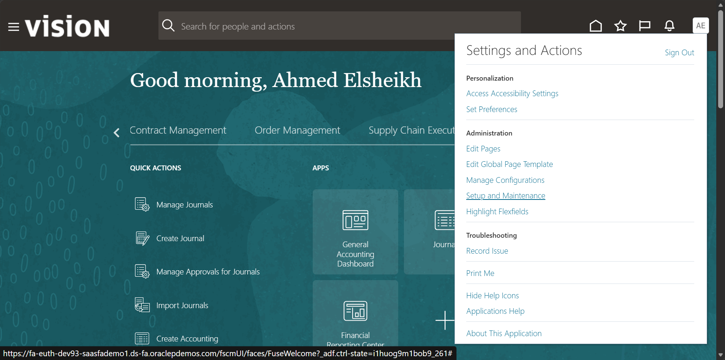
Step 1: Setup and Maintenance

Slide 6
Step 1: Setup and Maintenance
Open the Settings and Actions menu from the user avatar on the Oracle Fusion home page.
Select Setup and Maintenance to launch the Functional Setup Manager.
A setup role (for example, Application Implementation Consultant) is required to see this option

Slide 7
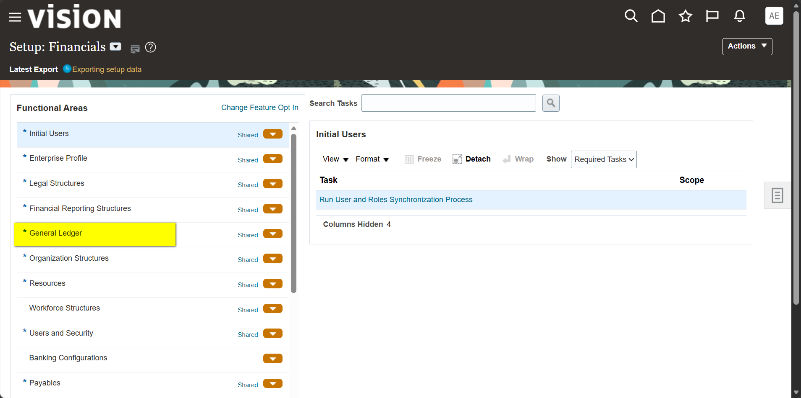
Step 2: General Ledger

Slide 8
Step 2: General Ledger
In the Setup: Financials offering, select the General Ledger functional area from the left panel.
The default Required Tasks filter shows only mandatory tasks.
Switch the Show filter to All Tasks to display the complete list of GL setup tasks.

Slide 9
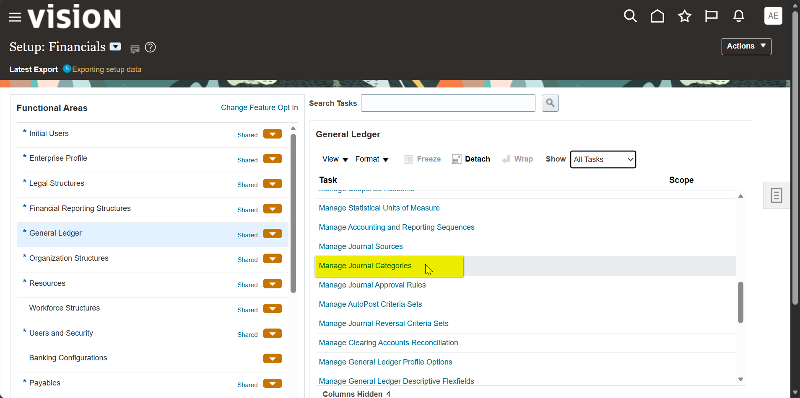
Step 3: Manage Journal Categories

Slide 10
Step 3: Manage Journal Categories
With All Tasks displayed, scroll the task list to the journal configuration tasks.
Select Manage Journal Categories, located next to Manage Journal Sources and Manage Journal Approval Rules.

Slide 11
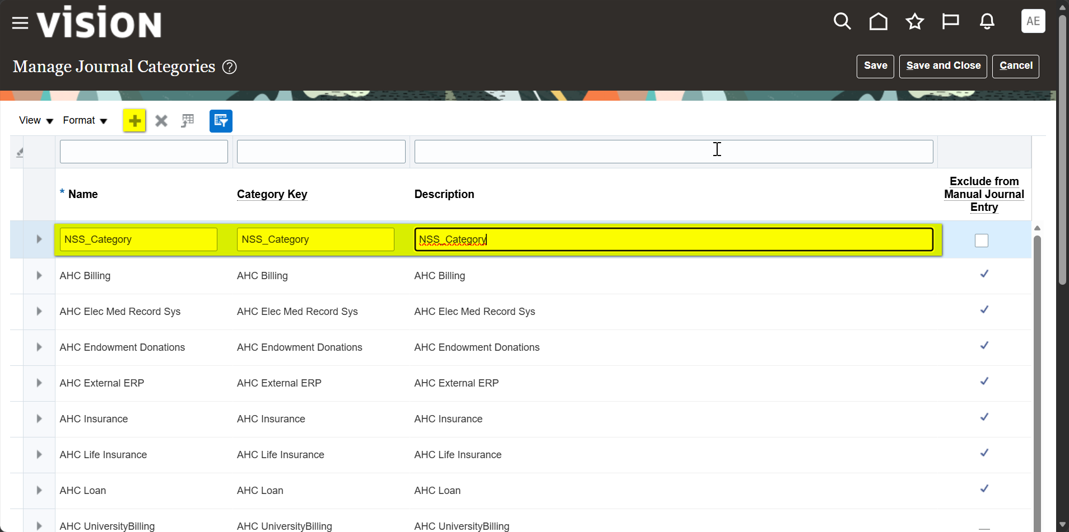
Step 4: Creating Category

Slide 12
Step 4: Creating Category
Click Add Row (+) to create a new category line.
Enter Name, Category Key and Description as NSS_Category; the Name is mandatory.
Leave Exclude from Manual Journal Entry cleared so the category can be used on manually entered journals.
Click Save and Close to commit the new category.

Slide 13
Part 2: Create Journal Sequence
Overview
Accounting and reporting sequences assign unique, sequential numbers to journals to support audit and statutory requirements.
The setup has two stages: define the Sequence (with a version), then link it through a Sequencing Assignment.
Both are maintained in the Manage Accounting and Reporting Sequences task.

Slide 14
Step 1: Setup and Maintenance

Slide 15
Step 1: Setup and Maintenance
Open Settings and Actions and select Setup and Maintenance.
This opens the Functional Setup Manager used to reach all configuration tasks.

Slide 16
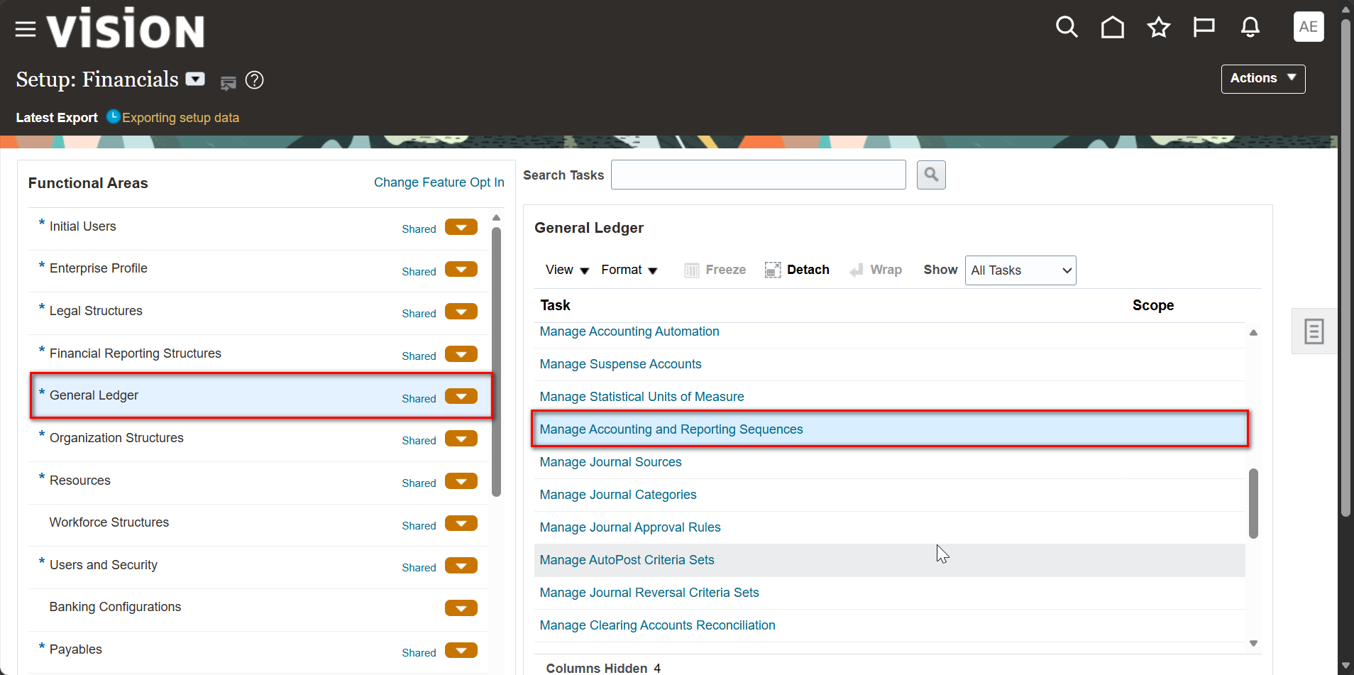
Step 2: General Ledger: Manage Accounting and Reporting Sequences

Slide 17
Step 2: General Ledger: Manage Accounting and Reporting Sequences
Select the General Ledger functional area in the Setup: Financials offering.
With All Tasks displayed, open Manage Accounting and Reporting Sequences

Slide 18
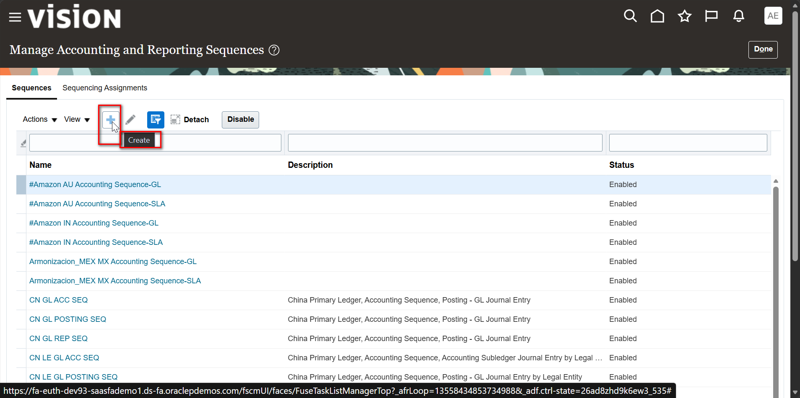
Step 3: Create a New Sequence

Slide 19
Step 3: Create a New Sequence
The page has two tabs: Sequences and Sequencing Assignments.
The Sequences tab lists existing sequences with their Name, Description and Status.
Click Create (+) to define a new sequence.

Slide 20
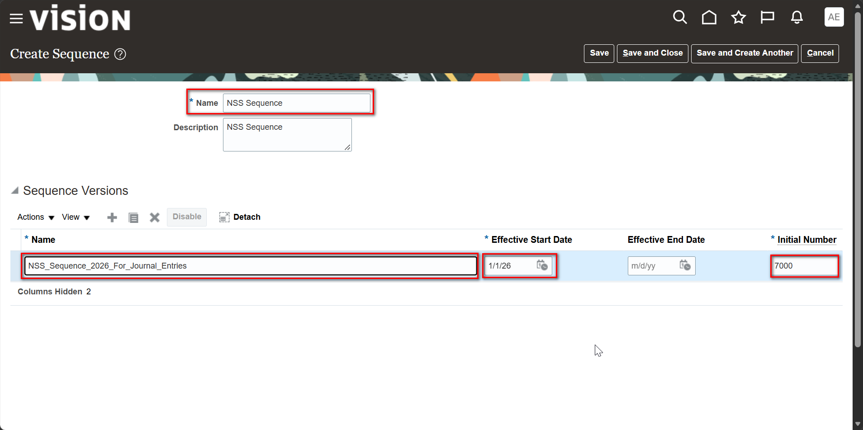
Step 4: Create Sequence: Name and Version

Slide 21
Step 4: Create Sequence: Name and Version
Enter the sequence Name and Description (NSS Sequence).
In Sequence Versions, define the version name, Effective Start Date (1/1/26) and Initial Number (7000).
The Effective End Date is left blank, keeping the version open-ended.
Click Save and Close to create the sequence.

Slide 22
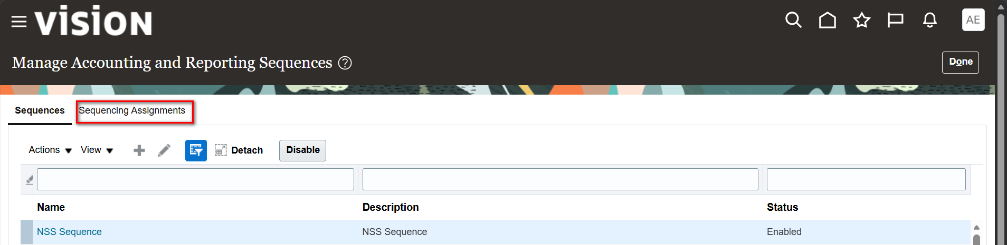
Step 5: Sequence Created: Open Sequencing Assignments

Slide 23
Step 5: Sequence Created: Open Sequencing Assignments
The new NSS Sequence appears in the list with the status Enabled.
Open the Sequencing Assignments tab to link the sequence to a ledger and journal attributes

Slide 24
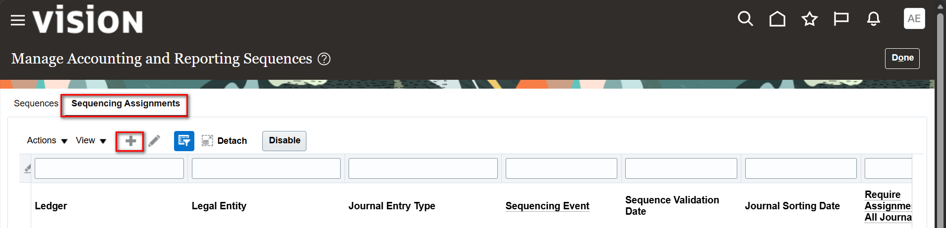
Step 6: Sequencing Assignments: Create

Slide 25
Step 6: Sequencing Assignments: Create
The grid shows the assignment attributes: Ledger, Legal Entity, Journal Entry Type, Sequencing Event and Sequence Validation Date.
Click Create (+) to add a new sequencing assignment.

Slide 26
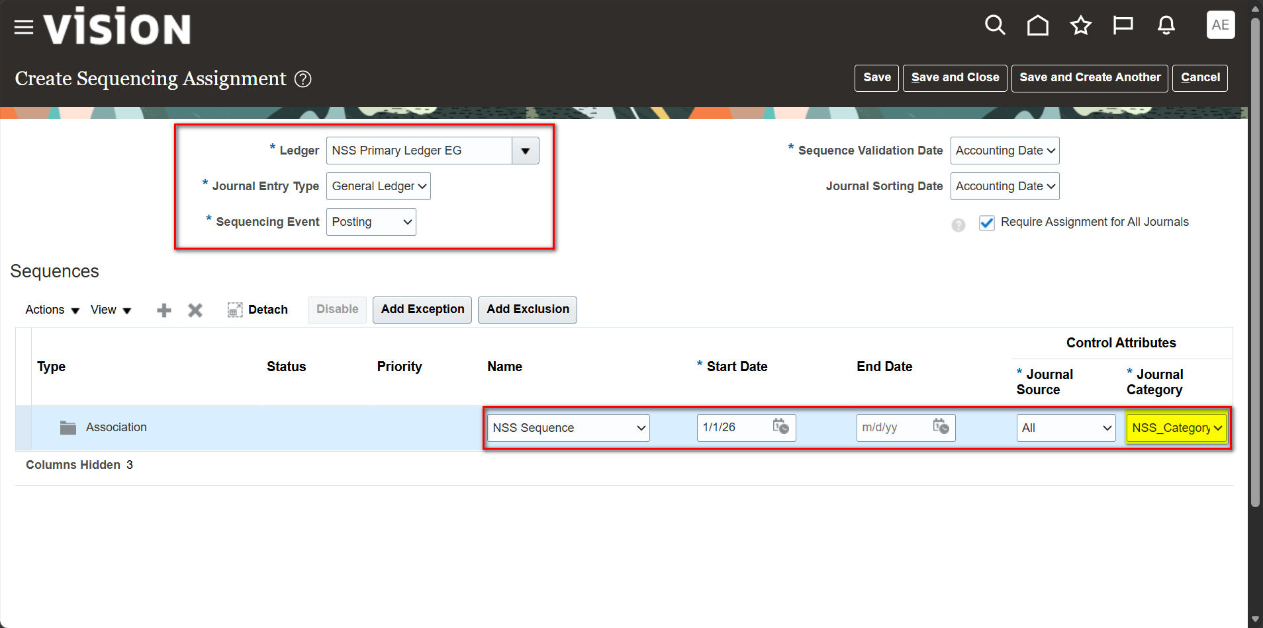
Step 7: Create Sequencing Assignment: Posting

Slide 27
Step 7: Create Sequencing Assignment: Posting
Set Ledger to NSS Primary Ledger EG, Journal Entry Type to General Ledger and Sequencing Event to Posting.
Keep Sequence Validation Date and Journal Sorting Date as Accounting Date; Require Assignment for All Journals is selected.
In the Sequences region, add an Association using NSS Sequence with a Start Date of 1/1/26.
Set the Control Attributes: Journal Source = All and Journal Category = NSS_Category.

Slide 28
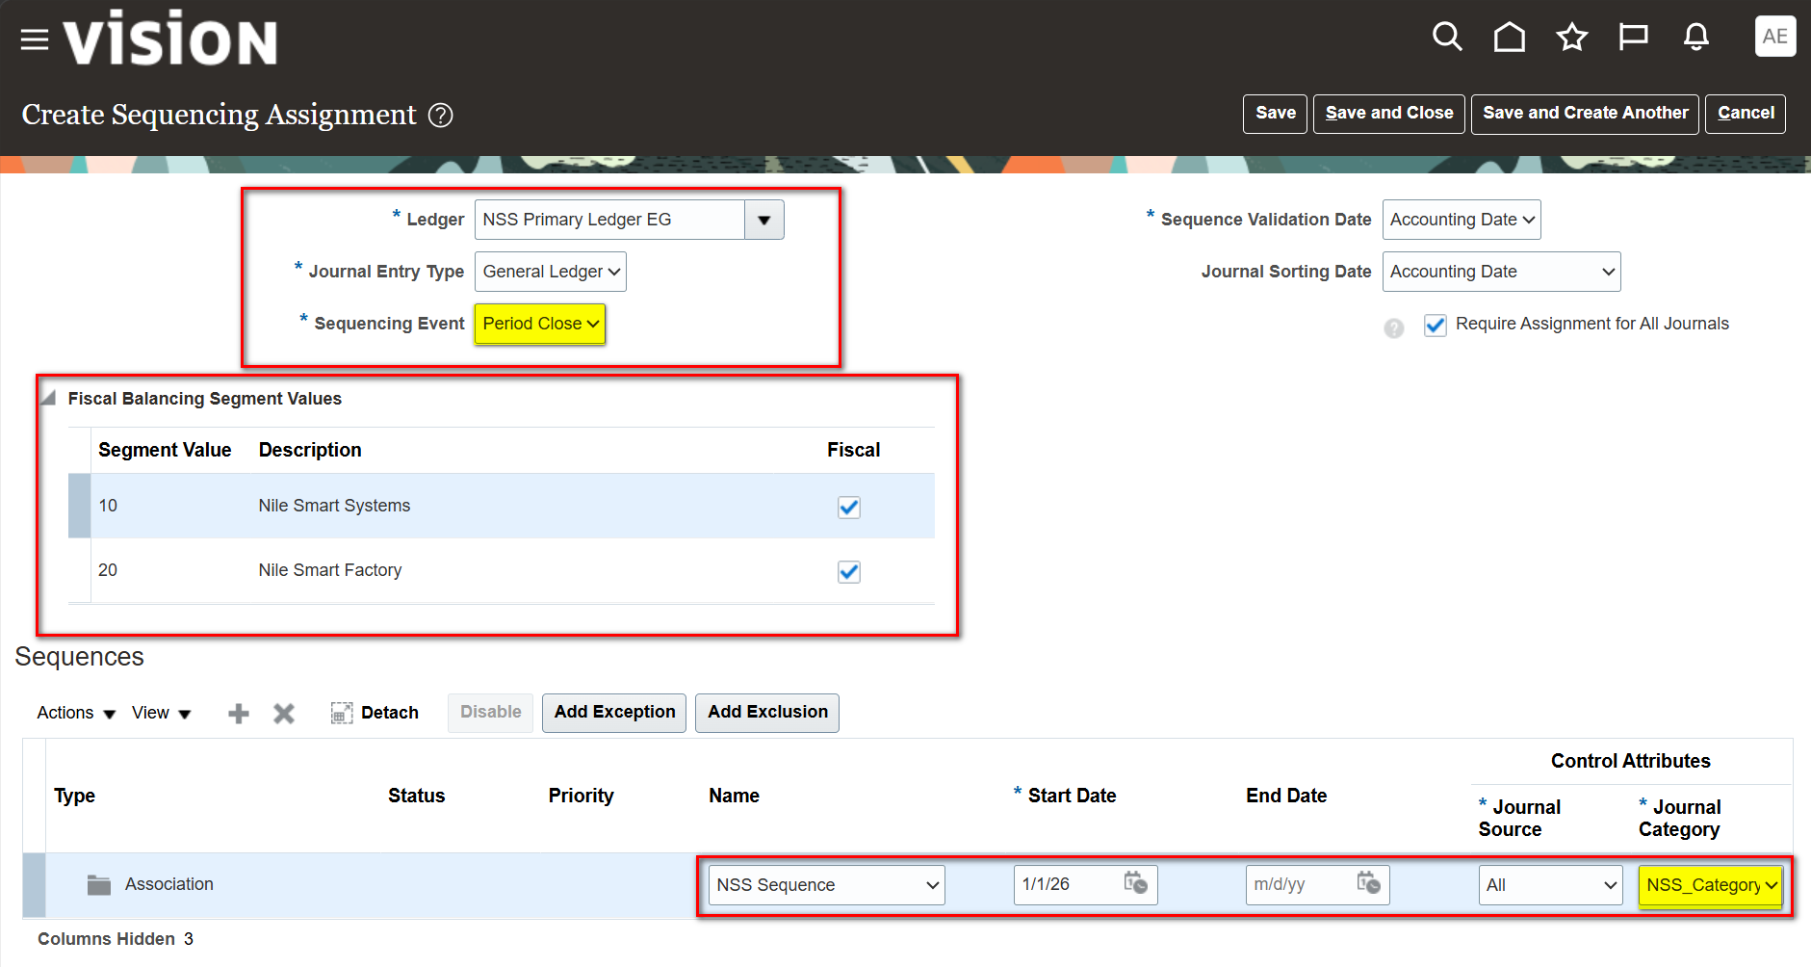
Step 8: Create Sequencing Assignment: Period Close

Slide 29
Step 8: Create Sequencing Assignment: Period Close
Change the Sequencing Event to Period Close to sequence journals when the period is closed.
The Fiscal Balancing Segment Values region lists the balancing segments, 10 (Nile Smart Systems) and 20 (Nile Smart Factory), flagged as Fiscal.
The same sequence and control attributes (Journal Source = All, Journal Category = NSS_Category) are associated.
Click Save and Close to complete the assignment.

Slide 30
Part 3: Create Batch with Many Journals
Overview
A journal batch groups several journals under one batch header so they can be completed, approved and posted together.
Journals are created manually from the Journals work area in the General Accounting dashboard.
Posting the batch submits a single process that posts all journals in it.

Slide 31
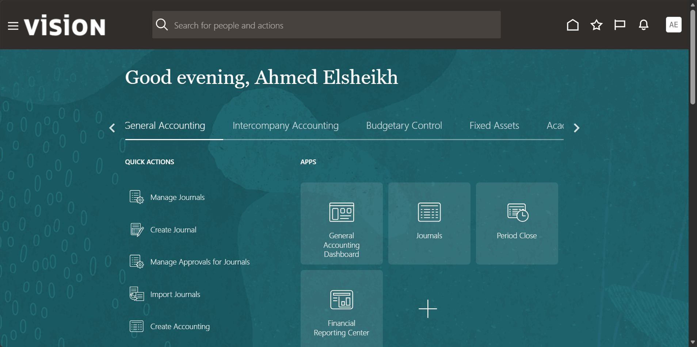
Step 1: General Accounting Home: Open Journals

Slide 32
Step 1: General Accounting Home: Open Journals
From the General Accounting home page, use Quick Actions (Manage Journals, Create Journal) or the Journals app tile.
The Journals work area is the entry point for journal entry, import and posting tasks

Slide 33
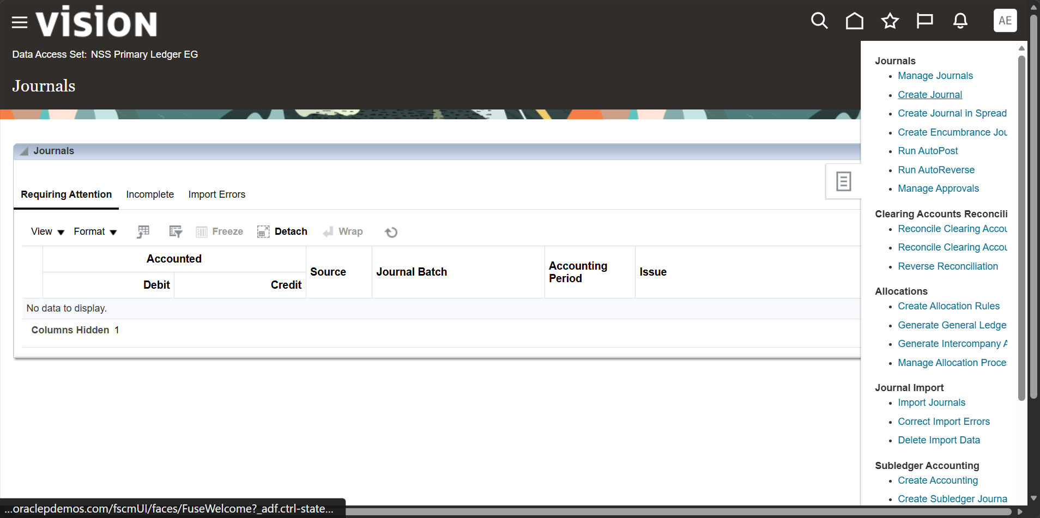
Step 2: Journals Page: Create Journal

Slide 34
Step 2: Journals Page: Create Journal
The Journals page is scoped to the Data Access Set (NSS Primary Ledger EG).
Open the Tasks panel and select Create Journal.
The panel also provides Manage Journals, Run AutoPost, Run AutoReverse and Import Journals

Slide 35
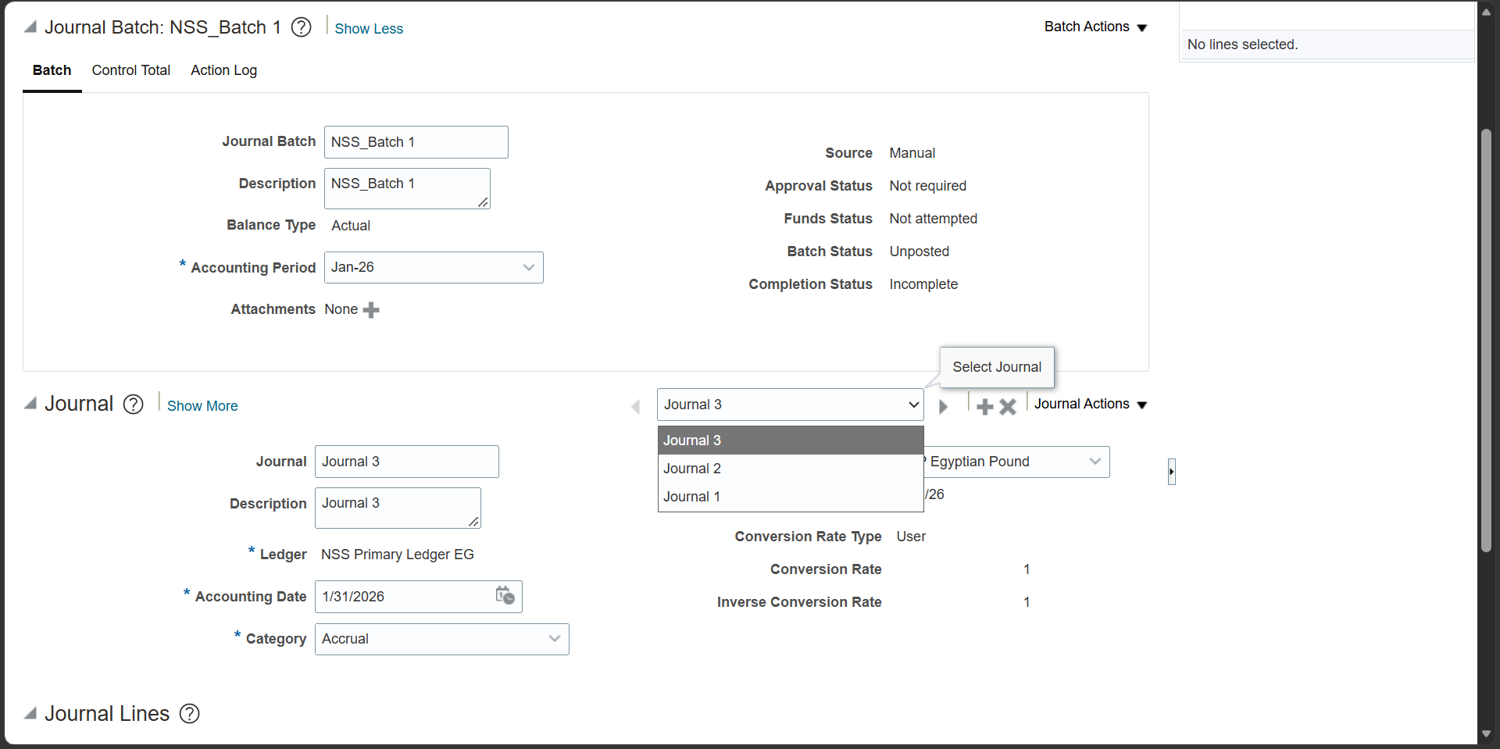
Step 3: Journal Batch NSS_Batch 1 with Multiple Journals

Slide 36
Step 3: Journal Batch NSS_Batch 1 with Multiple Journals
Enter the batch header: Journal Batch name, Description, Accounting Period (Jan-26); Balance Type is Actual and Source is Manual.
Use Add (+) in the Journal region to add Journal 1, Journal 2 and Journal 3 to the same batch.
Switch between journals using the Select Journal list.
Each journal carries its own Ledger, Accounting Date, Category (Accrual) and currency (EGP).

Slide 37
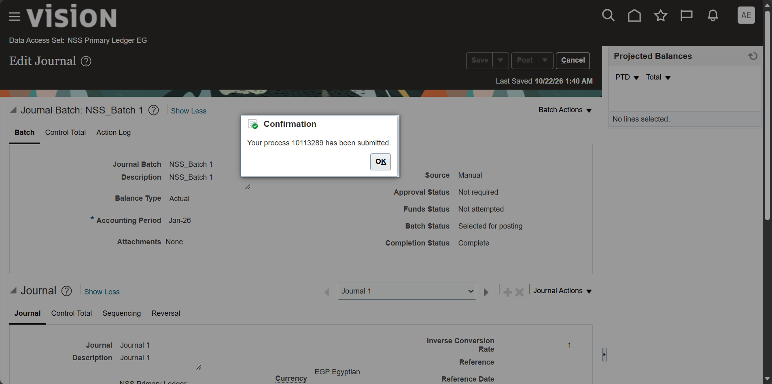
Step 4: Post the Batch: Confirmation Message

Slide 38
Step 4: Post the Batch: Confirmation Message
After the journals are completed, click Post to submit the posting process.
The Confirmation message returns the process ID of the submitted job.
The Batch Status changes to Selected for posting and the Completion Status is Complete.

Slide 39
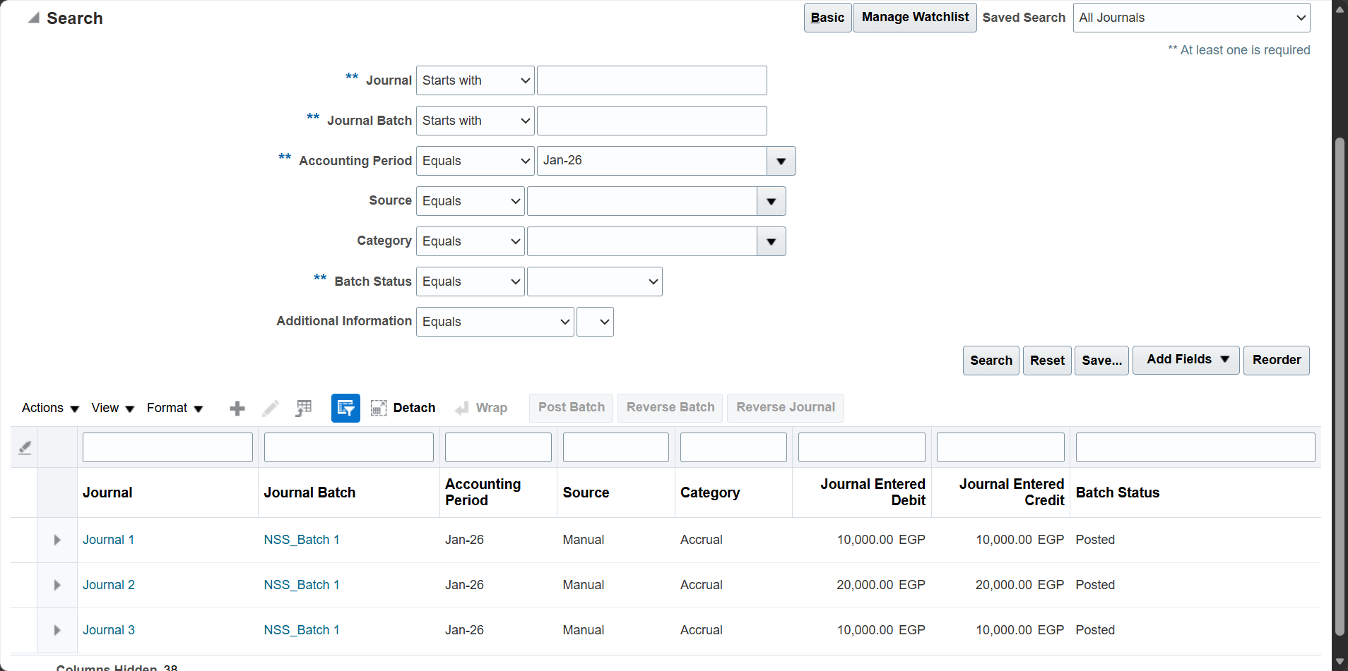
Step 5: Manage Journals: Batch Journals Posted

Slide 40
Step 5: Manage Journals: Batch Journals Posted
In Manage Journals, search by Accounting Period (Jan-26) to retrieve the batch.
All three journals under NSS_Batch 1 show Batch Status = Posted.
Journal Entered Debit equals Journal Entered Credit for each journal (10,000, 20,000 and 10,000 EGP).

Slide 41
Part 4: Reverse Journal
Overview
Journal reversal creates an offsetting journal in a later period to cancel the effect of a posted entry, typically for accruals.
The Reverse Batch action sets the reversal at batch level and overrides any journal-level reversal settings.
The reversal journal is generated as Unposted and must be posted to update balances.

Slide 42
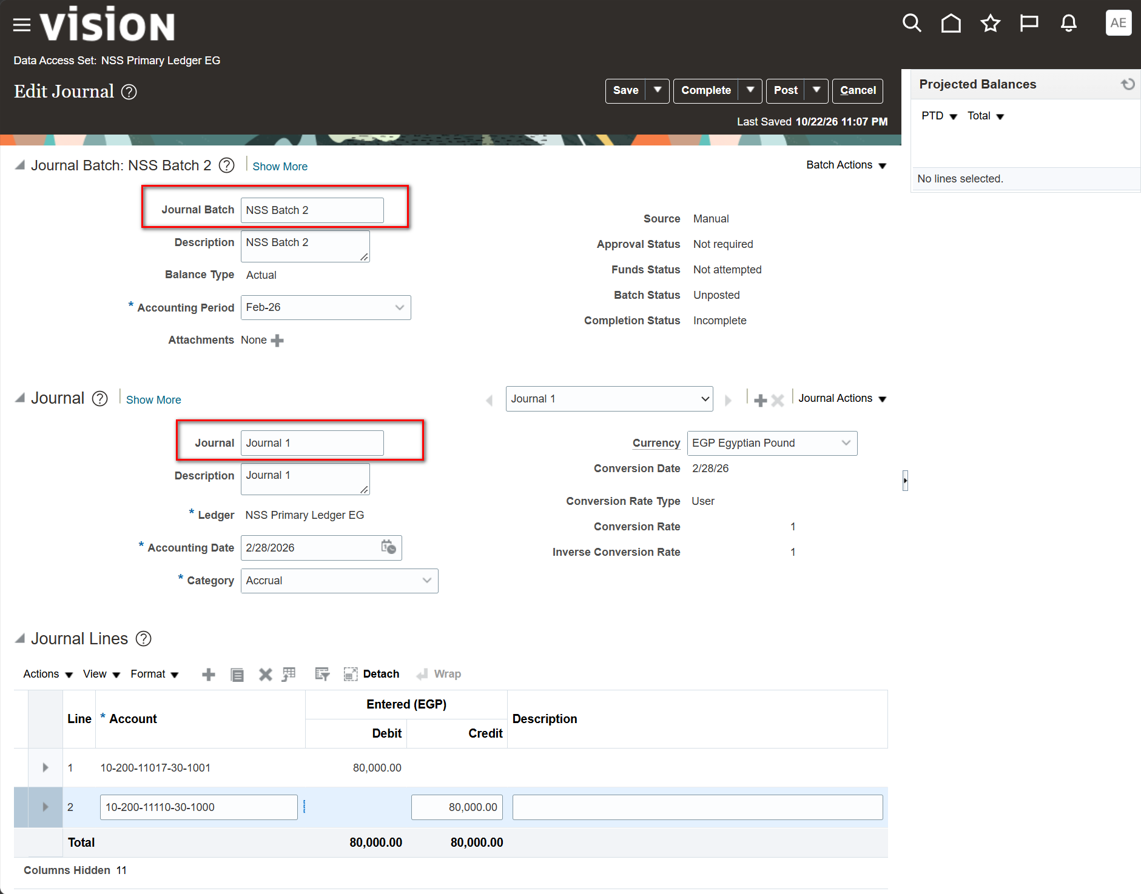
Step 1: Create Journal: Batch NSS Batch 2 with Journal Lines

Slide 43
Step 1: Create Journal: Batch NSS Batch 2 with Journal Lines
Create the batch header (NSS Batch 2, Accounting Period Feb-26) and the journal (Journal 1, Accounting Date 2/28/2026, Category Accrual).
Enter the Journal Lines: line 1 debit 80,000.00 and line 2 credit 80,000.00 in EGP.
The Total row confirms that debits equal credits before the journal is completed.

Slide 44
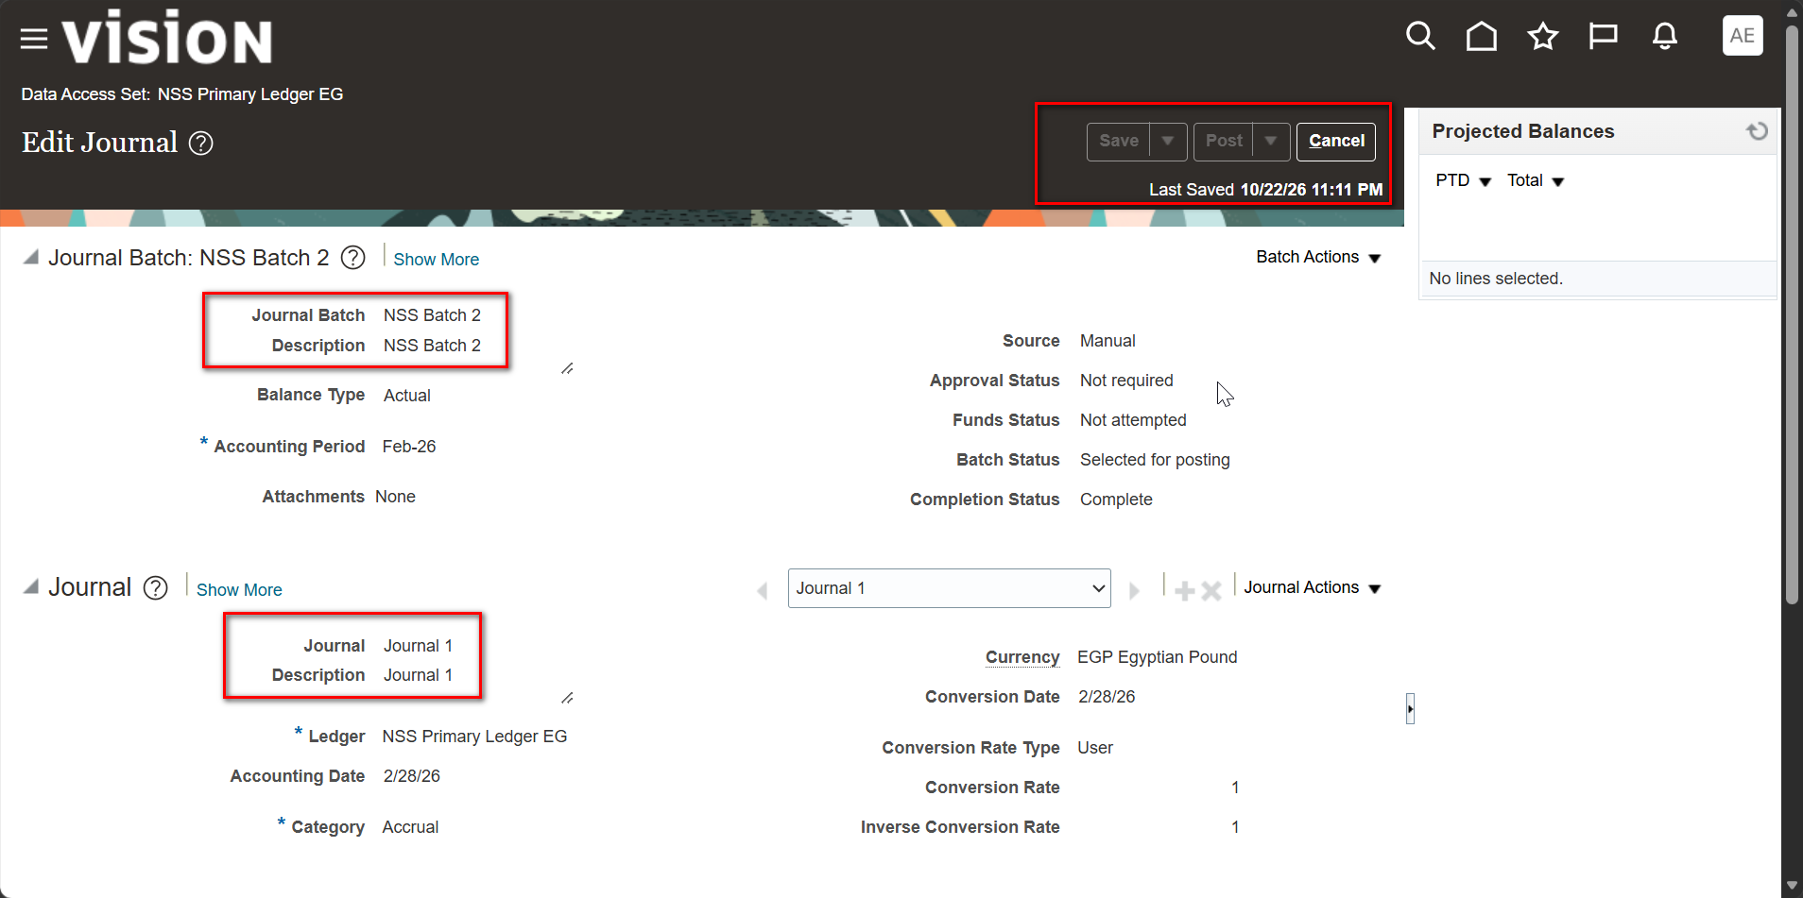
Step 2: Journal Saved and Selected for Posting

Slide 45
Step 2: Journal Saved and Selected for Posting
After Complete and Post, the Batch Status shows Selected for posting and the Completion Status is Complete.
The Last Saved timestamp confirms the save, and the Save and Post buttons are disabled while posting is in progress.

Slide 46
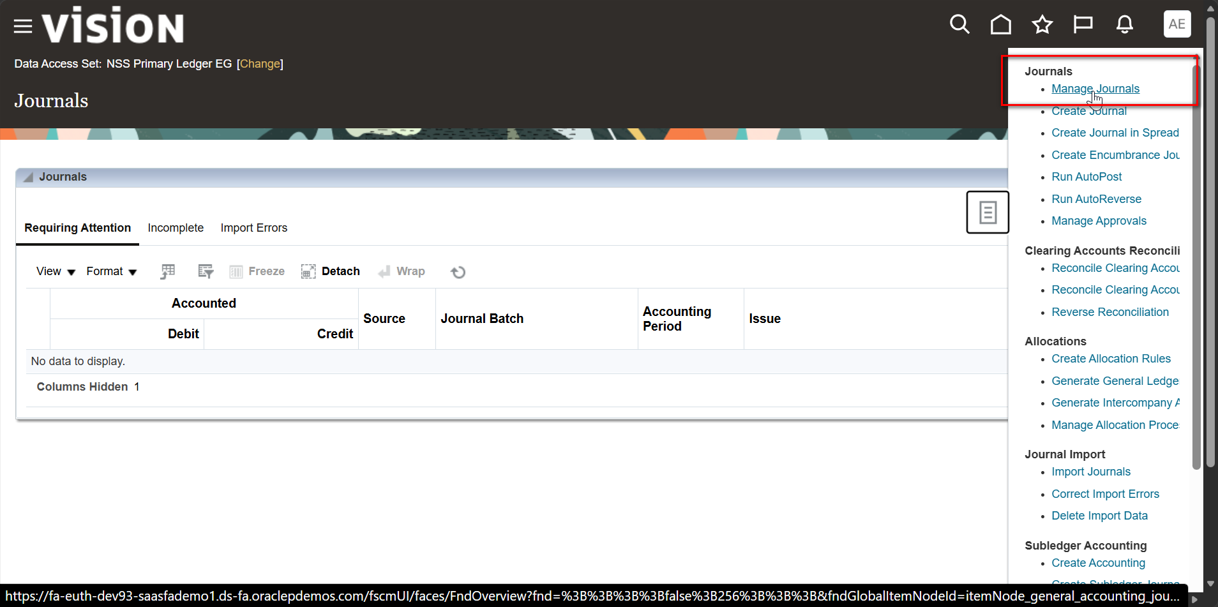
Step 3: Journals Page: Open Manage Journals

Slide 47
Step 3: Journals Page: Open Manage Journals
Return to the Journals page and open the Tasks panel.
Select Manage Journals to search for posted journals.

Slide 48
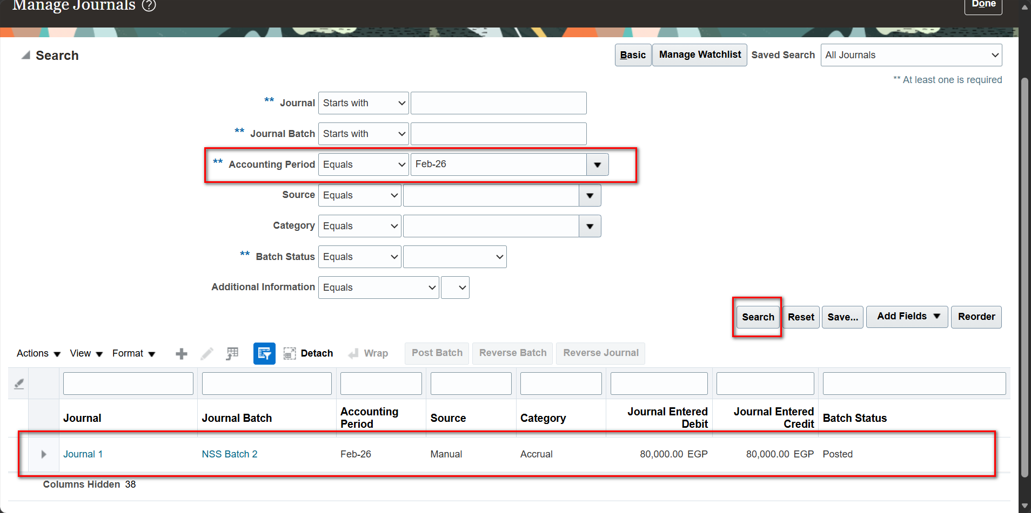
Step 4: Manage Journals: Search the Posted Journal

Slide 49
Step 4: Manage Journals: Search the Posted Journal
Set Accounting Period to Feb-26 and click Search.
Journal 1 in NSS Batch 2 is returned with Batch Status = Posted and amounts of 80,000.00 EGP.
Only posted batches are eligible for reversal.

Slide 50
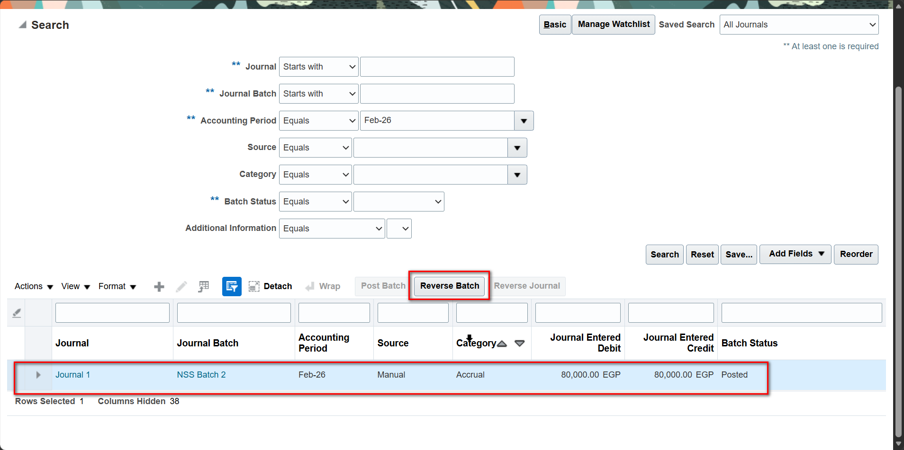
Step 5: Select the Journal and Click Reverse Batch

Slide 51
Step 5: Select the Journal and Click Reverse Batch
Select the posted journal row in the results table.
The Reverse Batch button becomes available; click it to start the reversal.

Slide 52
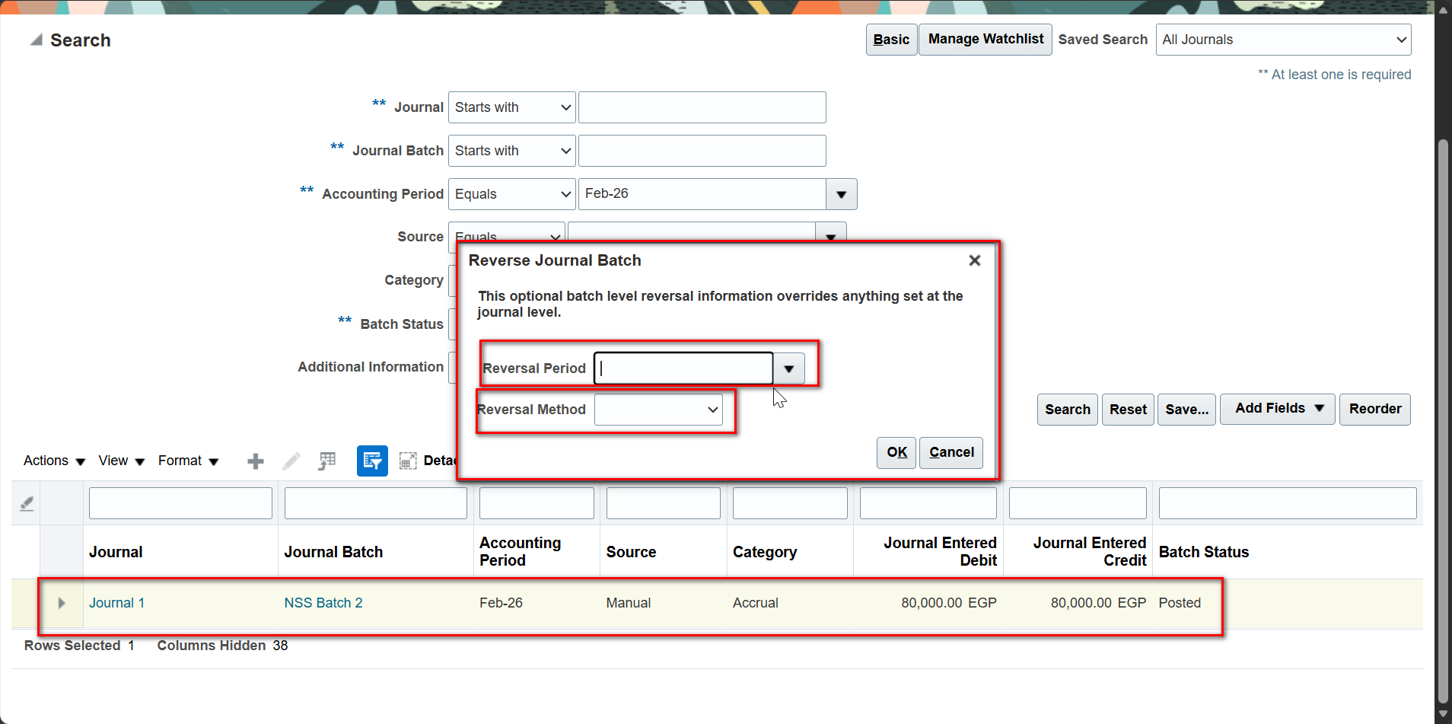
Step 6: Reverse Journal Batch Window

Slide 53
Step 6: Reverse Journal Batch Window
The Reverse Journal Batch window captures optional batch-level reversal information.
Batch-level values override anything defined at the journal level.
Two fields must be completed: Reversal Period and Reversal Method.

Slide 54
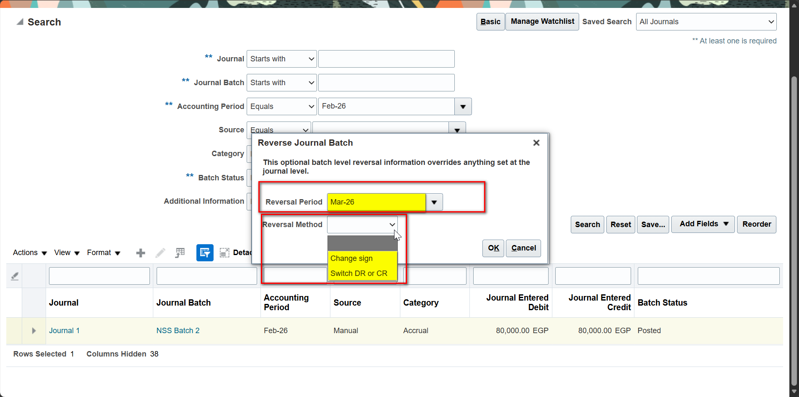
Step 7: Choose Reversal Period and Reversal Method

Slide 55
Step 7: Choose Reversal Period and Reversal Method
Select the Reversal Period (Mar-26), the period in which the reversal journal will be created.
Choose the Reversal Method: Change sign reverses the amounts with opposite signs; Switch DR or CR swaps the debit and credit sides.
Click OK to submit the reversal.

Slide 56
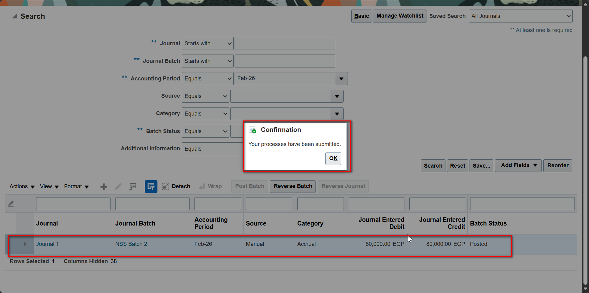
Step 8: Confirmation: Reversal Process Submitted

Slide 57
Step 8: Confirmation: Reversal Process Submitted
The Confirmation message states that the process was submitted.
The reversal runs as a scheduled process and generates the reversal journal in the selected period

Slide 58
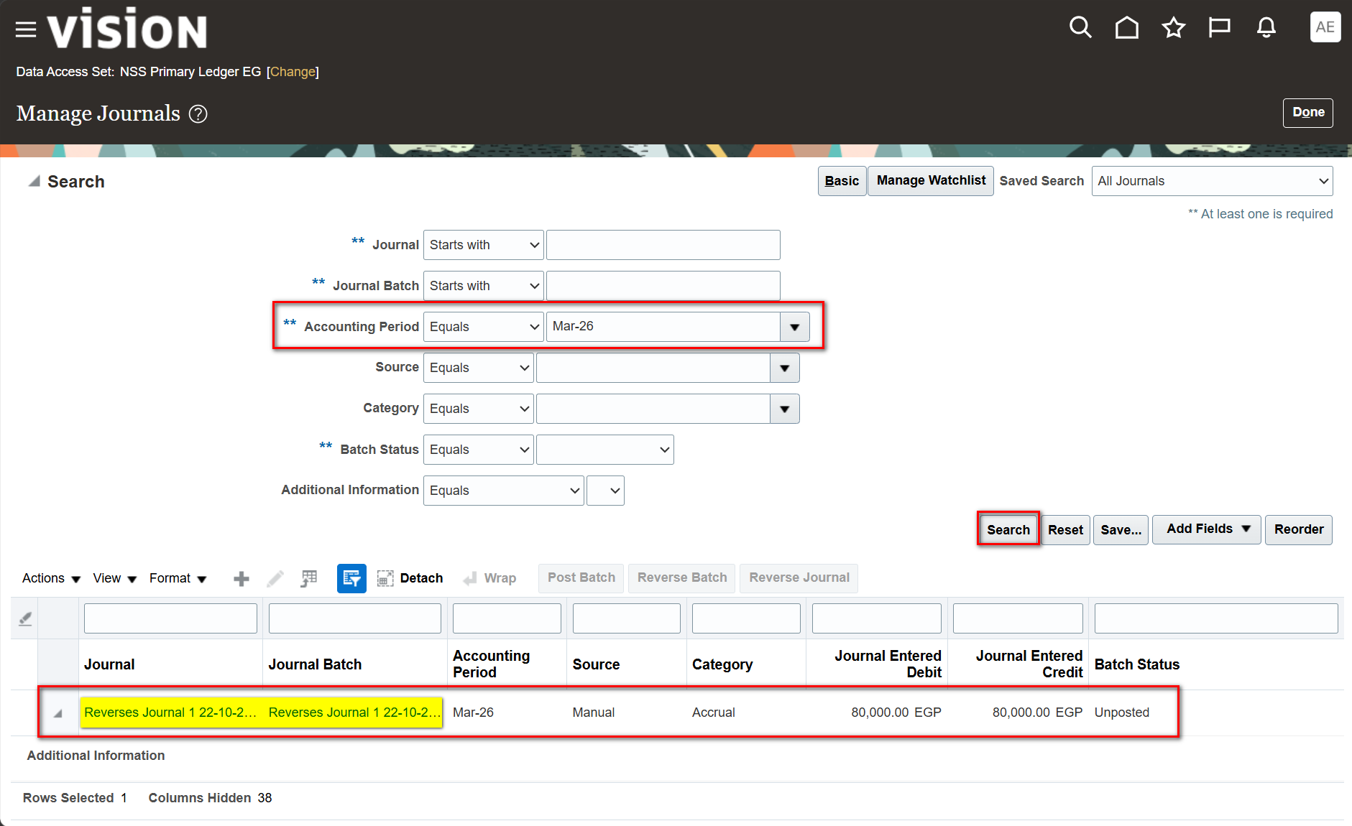
Step 9: Reversal Journal Created in the Next Period

Slide 59
Step 9: Reversal Journal Created in the Next Period
Search Accounting Period Mar-26 and click Search.
The system-generated journal, named "Reverses Journal 1 …", appears with 80,000.00 EGP debit and credit.
Its Batch Status is Unposted; post the batch to complete the reversal

Slide 60
Part 5: Intercompany
Overview
Intercompany balancing automatically generates receivable and payable lines when a journal is out of balance by balancing segment.
Balancing rules are evaluated by level: Primary Segment, Legal Entity, Ledger and Chart of Accounts.
Additional options control how generated lines are summarized and which clearing company is used.

Slide 61
Step 1: Setup and Maintenance

Slide 62
Step 1: Setup and Maintenance
Open Settings and Actions and select Setup and Maintenance.
This launches the Functional Setup Manager for the Financials offering.

Slide 63
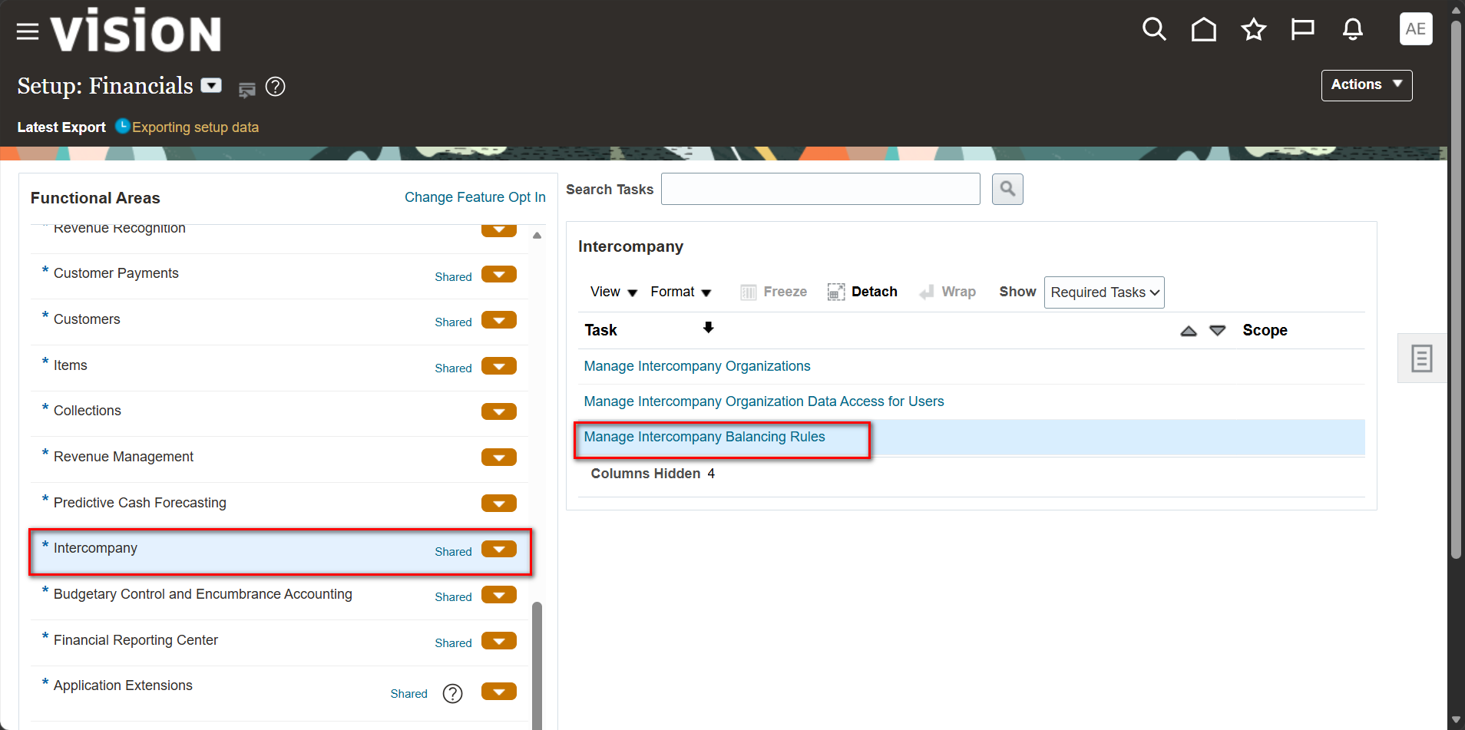
Step 2: Intercompany: Manage Intercompany Balancing Rules

Slide 64
Step 2: Intercompany: Manage Intercompany Balancing Rules
Select the Intercompany functional area in Setup: Financials.
The task list includes Manage Intercompany Organizations and Manage Intercompany Organization Data Access for Users.
Open Manage Intercompany Balancing Rules.

Slide 65
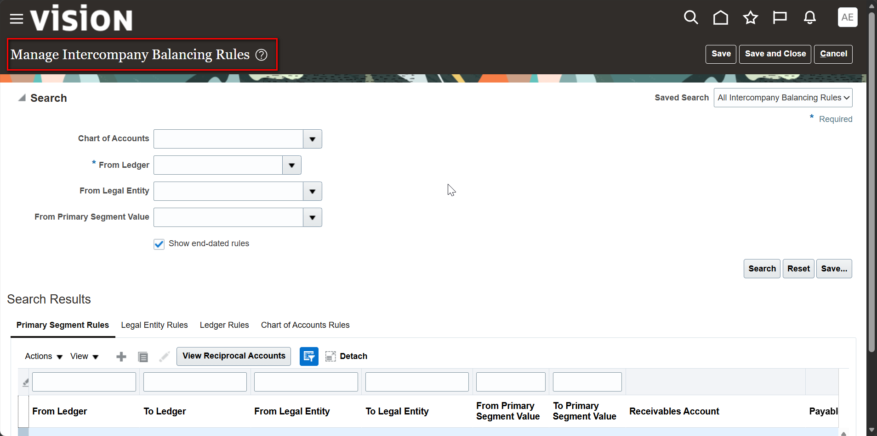
Step 3: Manage Intercompany Balancing Rules: Primary Segment Rules

Slide 66
Step 3: Manage Intercompany Balancing Rules: Primary Segment Rules
The search region filters by Chart of Accounts, From Ledger (required), From Legal Entity and From Primary Segment Value.
The results are grouped in tabs: Primary Segment Rules, Legal Entity Rules, Ledger Rules and Chart of Accounts Rules.
Use View Reciprocal Accounts to review the receivables and payables accounts, and Add (+) to create a rule.

Slide 67
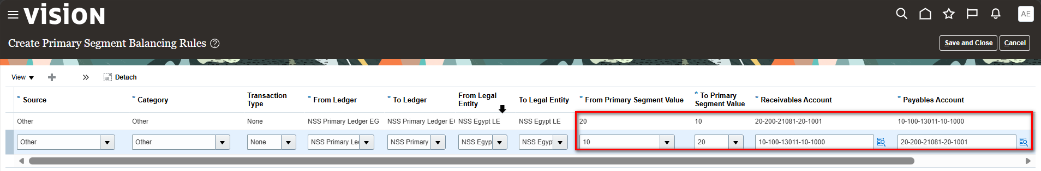
Step 4: Create Primary Segment Balancing Rules

Slide 68
Step 4: Create Primary Segment Balancing Rules
Set Source and Category to Other, Transaction Type to None, and From/To Ledger to NSS Primary Ledger EG.
Set From/To Legal Entity to NSS Egypt LE.
Define the first rule: From Primary Segment Value 10 to To Primary Segment Value 20, with the Receivables Account 10-100-13011-10-1000 and Payables Account 20-200-21081-20-1001.
Define the reciprocal rule from 20 to 10 with the receivables and payables accounts swapped.

Slide 69
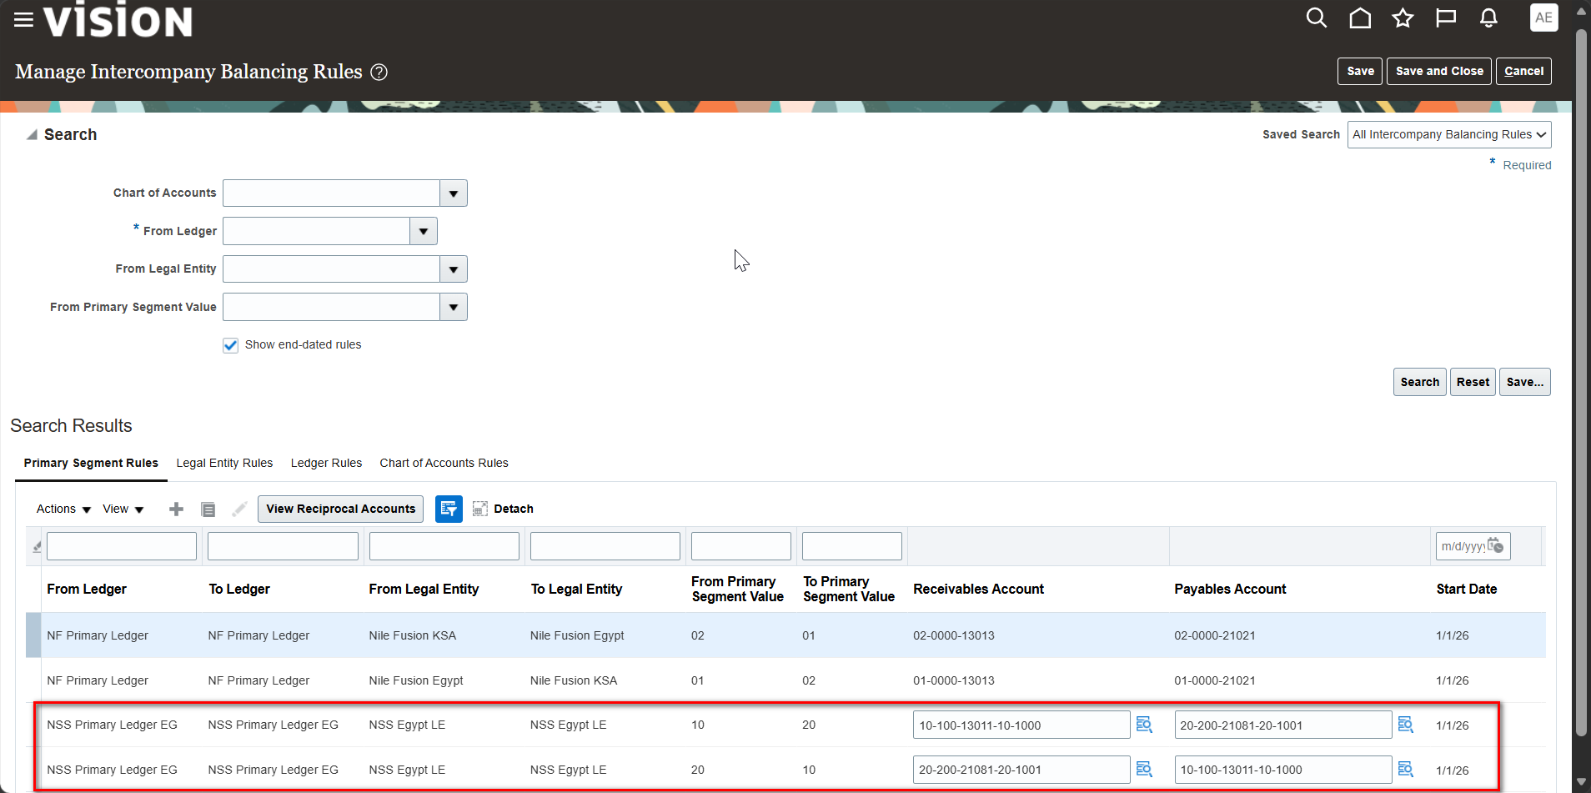
Step 5: Balancing Rules Created

Slide 70
Step 5: Balancing Rules Created
Both rules (10 to 20 and 20 to 10) are listed under Primary Segment Rules with a Start Date of 1/1/26.
The receivables account of one rule is the payables account of its reciprocal rule.

Slide 71
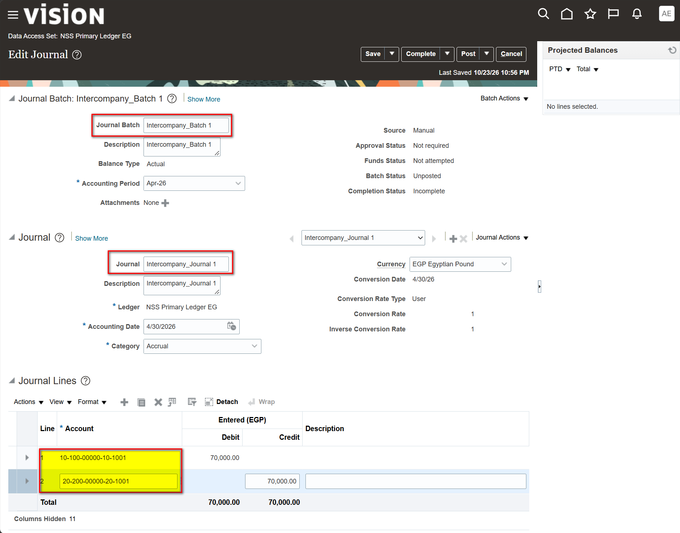
Step 6: Create an Intercompany Journal

Slide 72
Step 6: Create an Intercompany Journal
Create the batch (Intercompany_Batch 1, Accounting Period Apr-26) and the journal (Intercompany_Journal 1, Accounting Date 4/30/2026).
Line 1 debits account 10-100-00000-10-1001 by 70,000.00 (balancing segment 10).
Line 2 credits account 20-200-00000-20-1001 by 70,000.00 (balancing segment 20).
The journal balances in total but not by balancing segment, so intercompany balancing is triggered at posting.

Slide 73
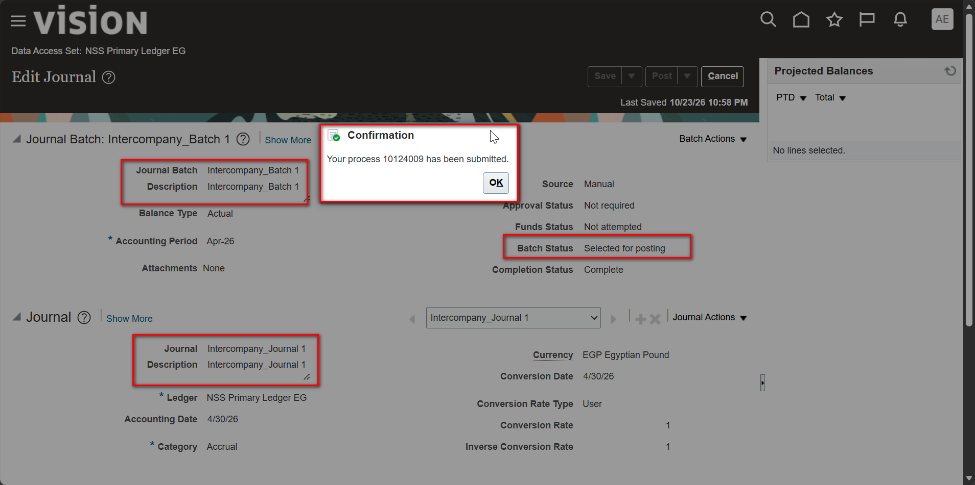
Step 7: Post the Journal: Confirmation Message

Slide 74
Step 7: Post the Journal: Confirmation Message
Click Post to submit the posting process; the Confirmation message returns the process ID.
The Batch Status is Selected for posting and the Completion Status is Complete.

Slide 75
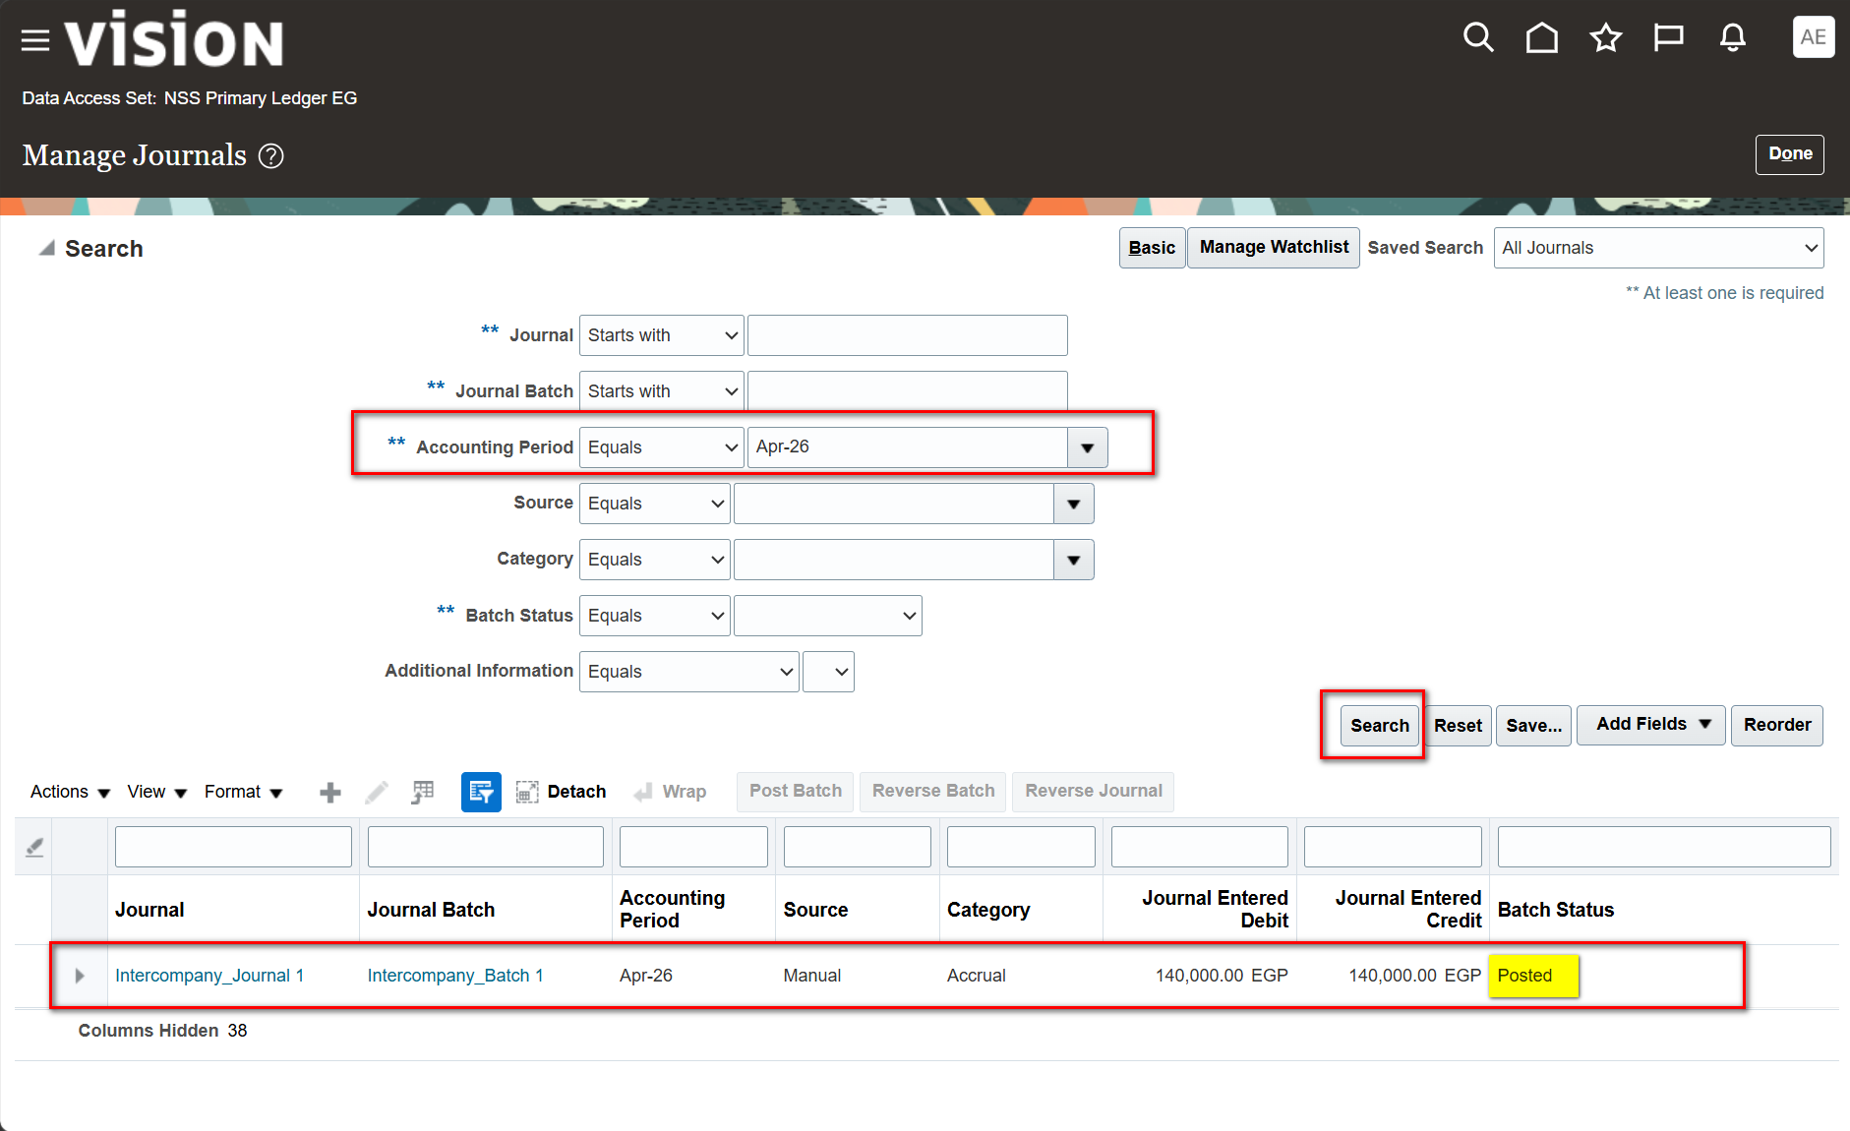
Step 8: Manage Journals: Intercompany Journal Posted

Slide 76
Step 8: Manage Journals: Intercompany Journal Posted
Search Accounting Period Apr-26 and click Search.
The Batch Status is Posted.
Journal Entered Debit and Credit show 140,000.00 EGP, double the 70,000.00 entered, because the posting process added the balancing lines.

Slide 77
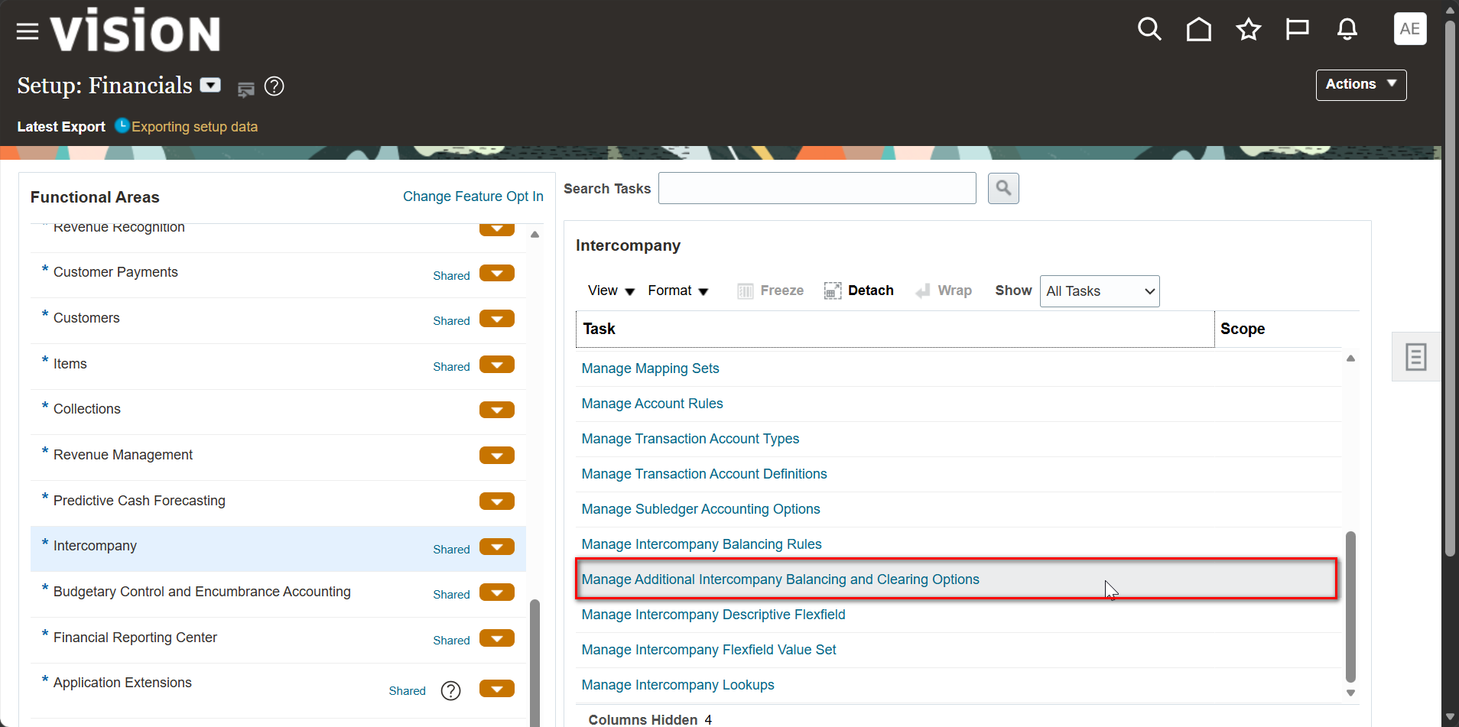
Step 9: Open Additional Intercompany Balancing and Clearing Options

Slide 78
Step 9: Open Additional Intercompany Balancing and Clearing Options
In the Intercompany functional area, switch Show to All Tasks.
Open Manage Additional Intercompany Balancing and Clearing Options, listed below Manage Intercompany Balancing Rules.

Slide 79
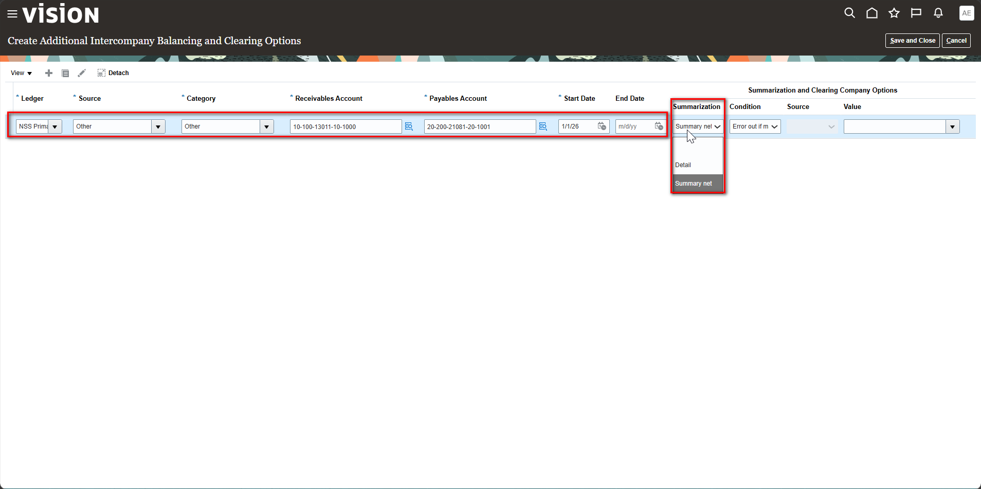
Step 10: Create Additional Options: Summarization

Slide 80
Step 10: Create Additional Options: Summarization
Select the Ledger, Source and Category, then enter the Receivables Account, Payables Account and Start Date.
The Summarization list offers Detail and Summary net.
Summary net consolidates the generated intercompany lines into net amounts; Detail keeps them separate.

Slide 81
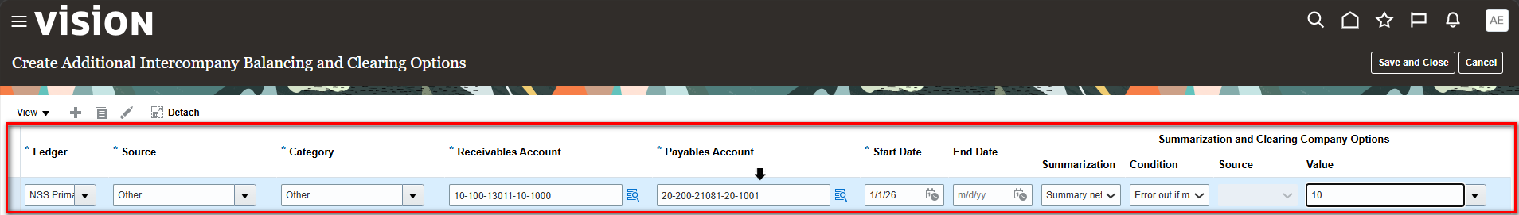
Step 11: Clearing Company Value
Under Summarization and Clearing Company Options, the Value field holds the clearing company balancing segment value (10).
The clearing company is used to balance journals when the standard intercompany rules cannot be applied.

Slide 82
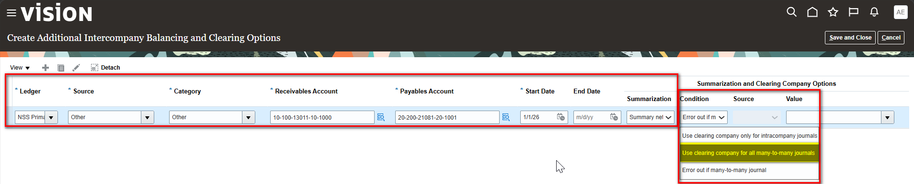
Step 12: Condition for Many-to-Many Journals
The Condition list controls how many-to-many journals (multiple debits and credits across balancing segments) are handled.
Options: Use clearing company only for intracompany journals, Use clearing company for all many-to-many journals and Error out if many-to-many journal.

Slide 83
Part 6: Cross-Validation Rules
Overview
Cross-validation rules restrict which segment value combinations can be created in the chart of accounts.
Each rule has a Condition Filter (when the rule applies), a Validation Filter (what is allowed) and an Error Message.
Rules are defined per chart of accounts in the Financial Reporting Structures functional area.

Slide 84
Step 1: Setup and Maintenance

Slide 85
Step 1: Setup and Maintenance
Open Settings and Actions and select Setup and Maintenance.
This opens the Functional Setup Manager.

Slide 86
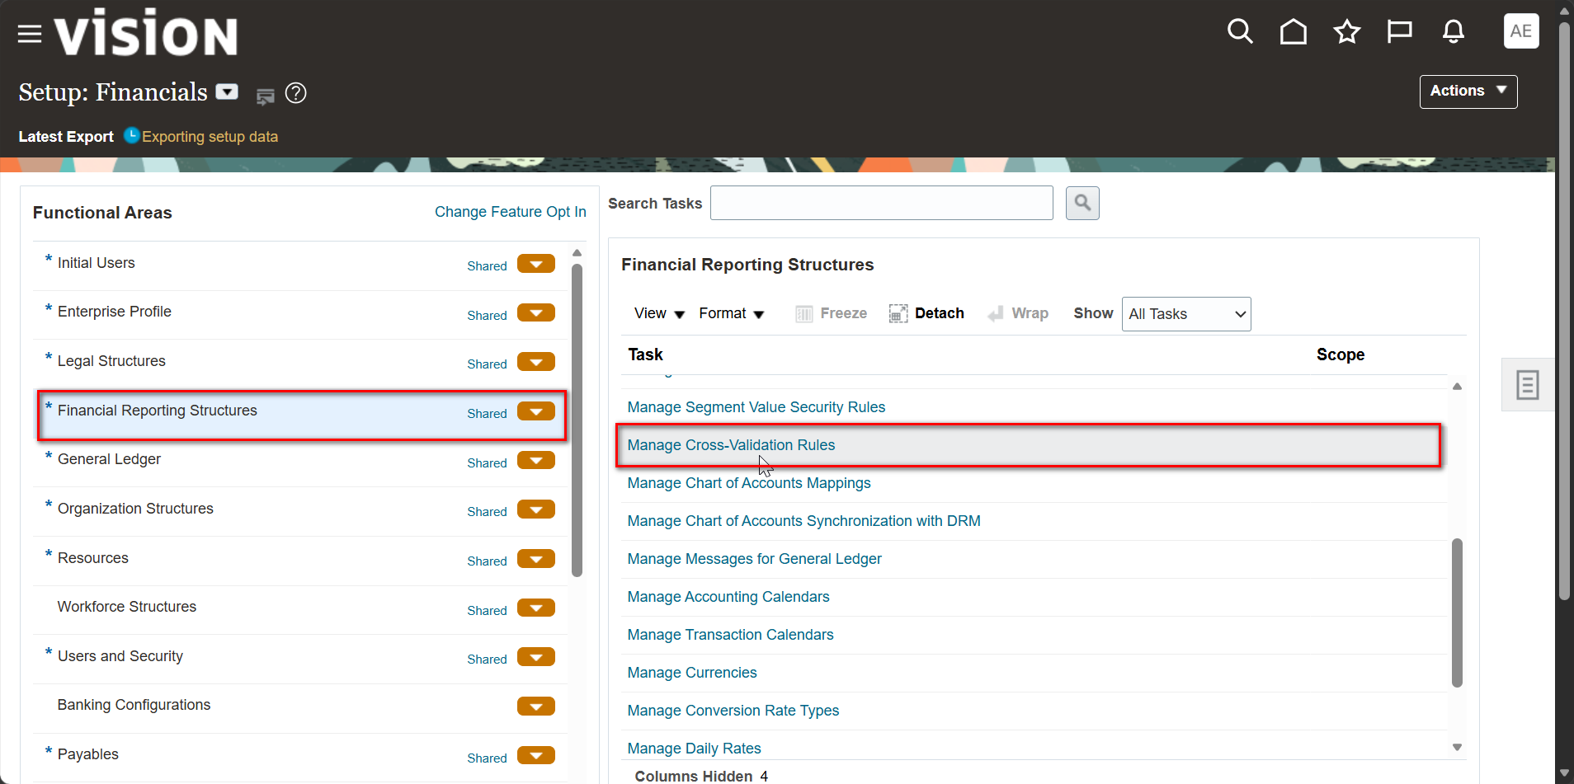
Step 2: Financial Reporting Structures: Manage Cross-Validation Rules

Slide 87
Step 2: Financial Reporting Structures: Manage Cross-Validation Rules
Select the Financial Reporting Structures functional area and set Show to All Tasks.
Open Manage Cross-Validation Rules, listed near Manage Segment Value Security Rules and Manage Chart of Accounts Mappings.

Slide 88
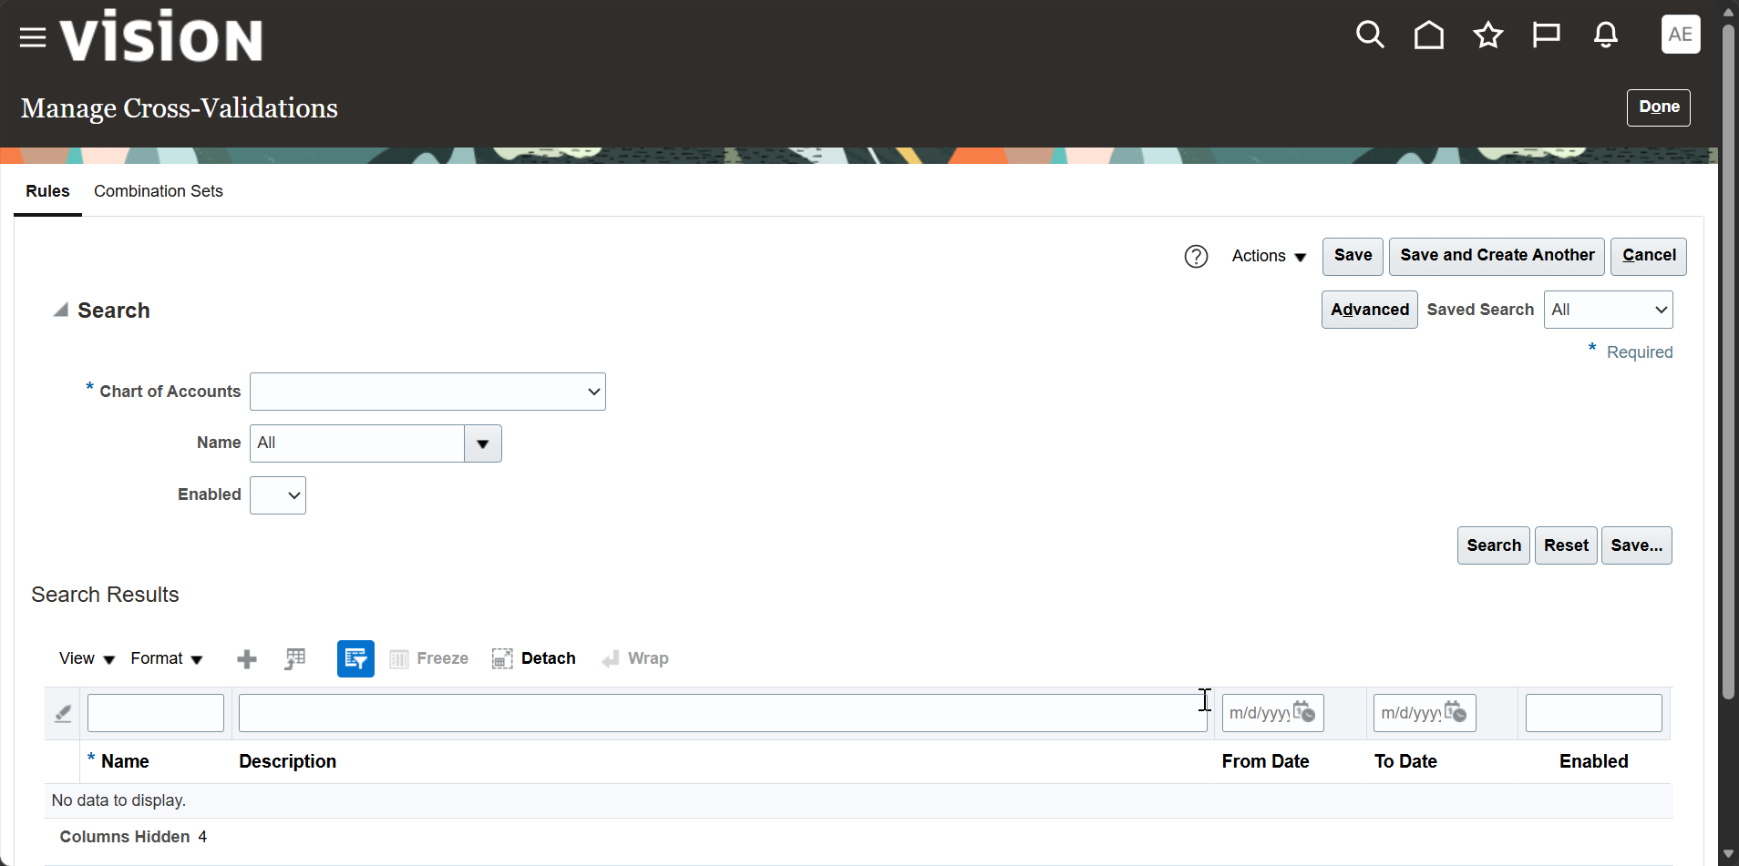
Step 3: Manage Cross-Validations: Rules Tab

Slide 89
Step 3: Manage Cross-Validations: Rules Tab
The page has two tabs: Rules and Combination Sets.
The search region requires a Chart of Accounts and can be refined by Name and Enabled.
No rules are displayed until a chart of accounts is selected.

Slide 90
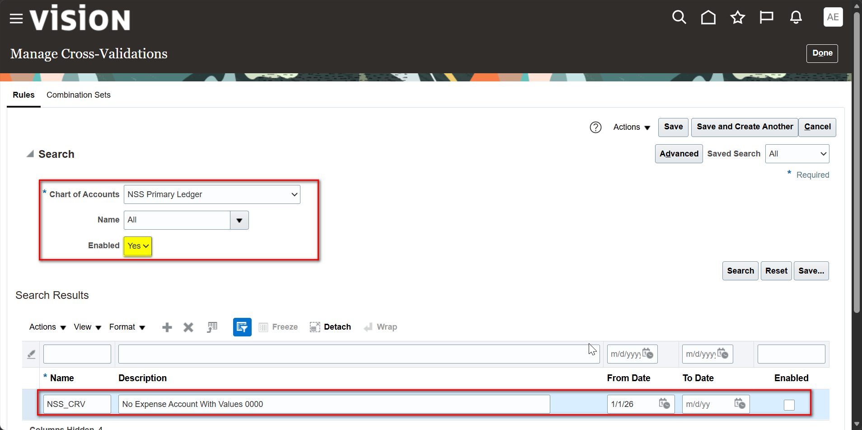
Step 4: Select the Chart of Accounts and Create the Rule

Slide 91
Step 4: Select the Chart of Accounts and Create the Rule
Select the Chart of Accounts (NSS Primary Ledger) and set Enabled to Yes.
Add a new rule with Name NSS_CRV, a Description and a From Date of 1/1/26.
The Enabled check box is cleared, so the rule is not enforced until it is enabled.

Slide 92
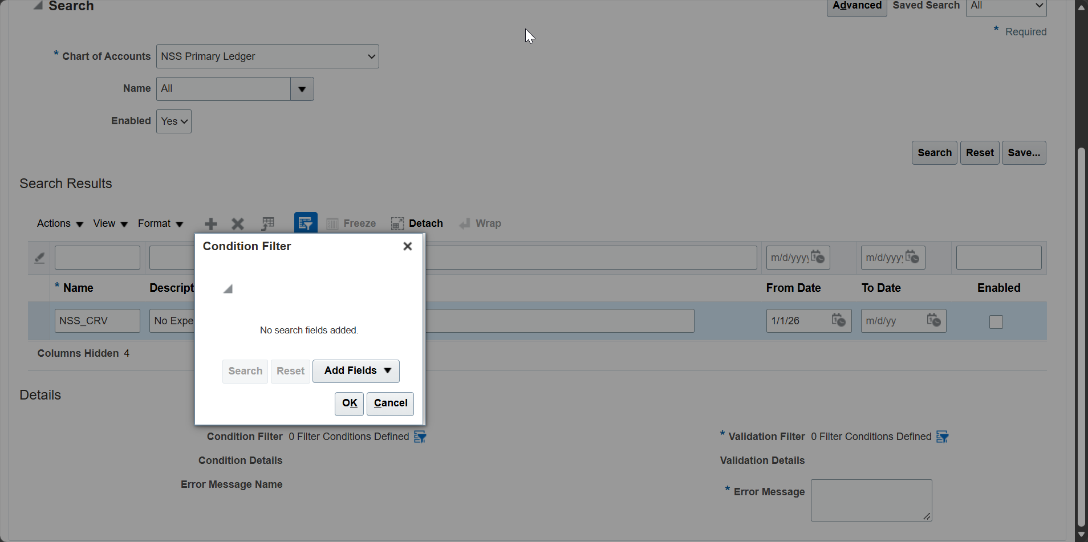
Step 5: Condition Filter: Add Fields

Slide 93
Step 5: Condition Filter: Add Fields
In the Details region, click the Condition Filter icon to open the filter dialog.
The dialog initially shows No search fields added.
Use Add Fields to select the segments (for example, Department and Account) to filter on.

Slide 94
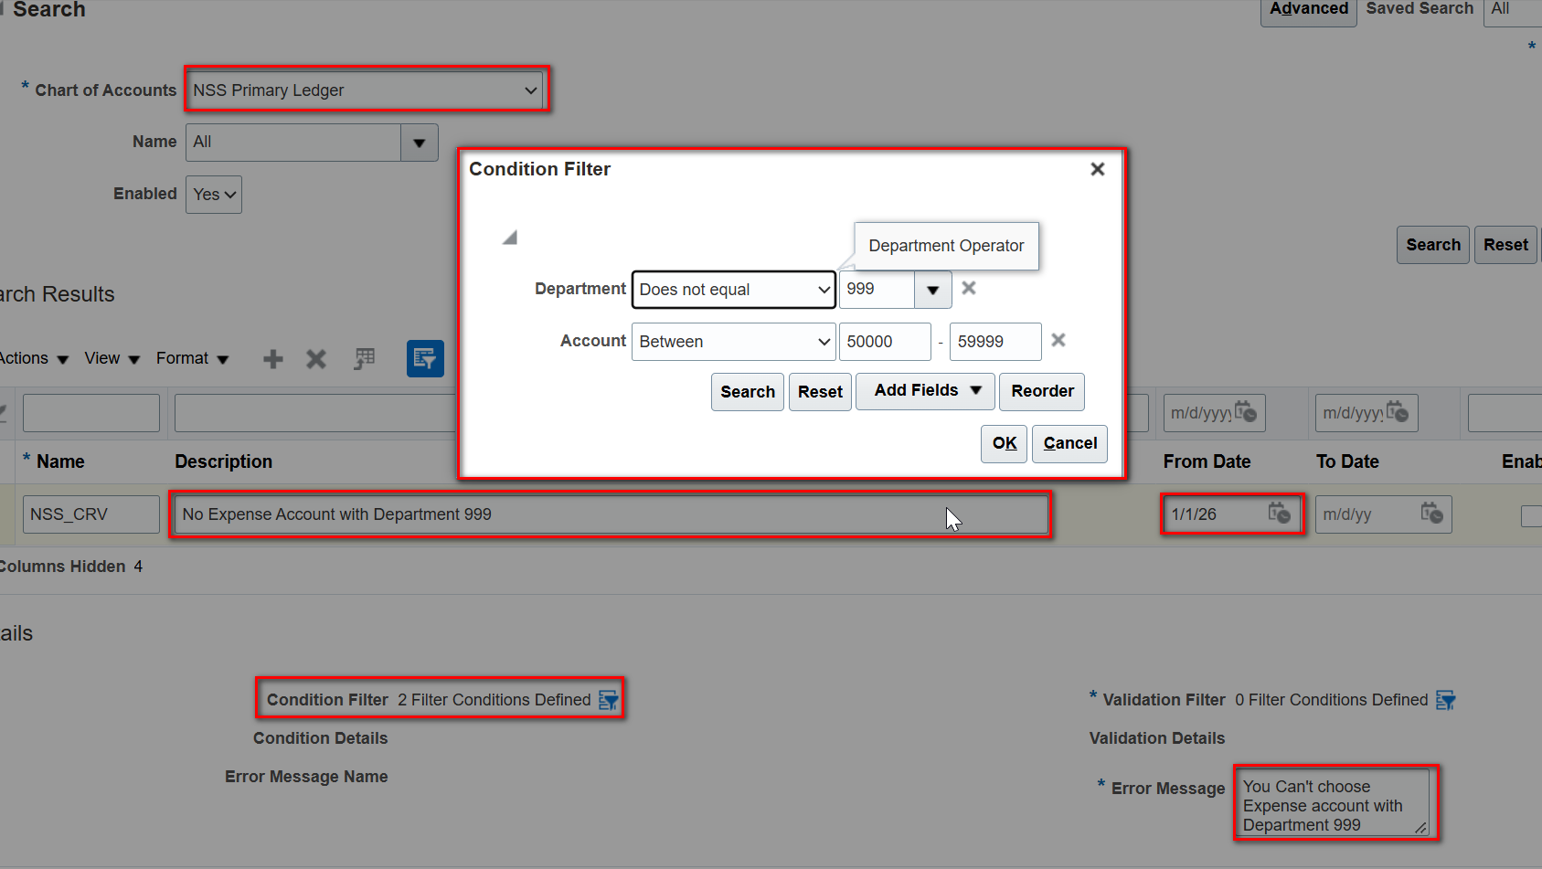
Step 6: Condition Filter: Department and Account Conditions

Slide 95
Step 6: Condition Filter: Department and Account Conditions
Define Department with the operator Does not equal 999.
Define Account with the operator Between 50000 and 59999 (the expense account range).
Enter the Error Message shown to users when the rule is violated, then click OK.

Slide 96
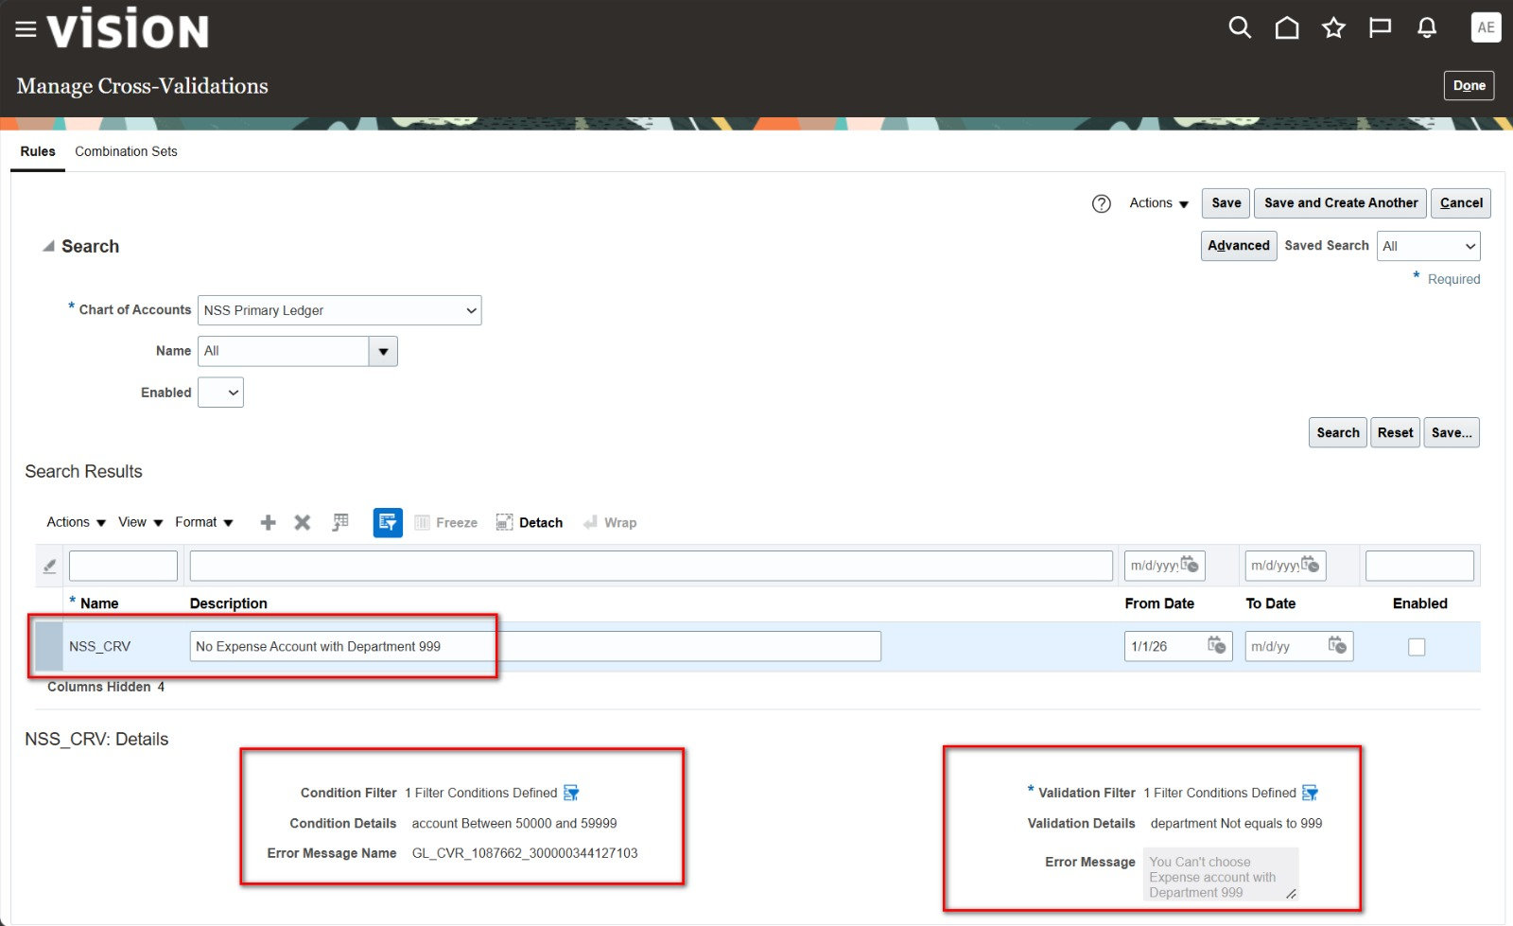
Step 7: Cross-Validation Rule Details

Slide 97
Step 7: Cross-Validation Rule Details
The Details region shows Condition Filter and Validation Filter, each with 2 filter conditions defined.
The details display: department Not equals to 999 AND account Between 50000 and 59999.
The system generates an Error Message Name, and the Error Message text is stored with the rule.
Click Save to store the rule.

Slide 98
Applications of Foreign Currency Transactions and Period-End Financial Settlements: Revaluation & Translation

Slide 99
Initial configuration of the Oracle environment to handle Multi-Currency Transactions by verifying the activation of the target foreign currencies.
• As a primary and essential step for processing foreign currencies, navigate to the Setup and Maintenance screen from the user's main menu.

Slide 100
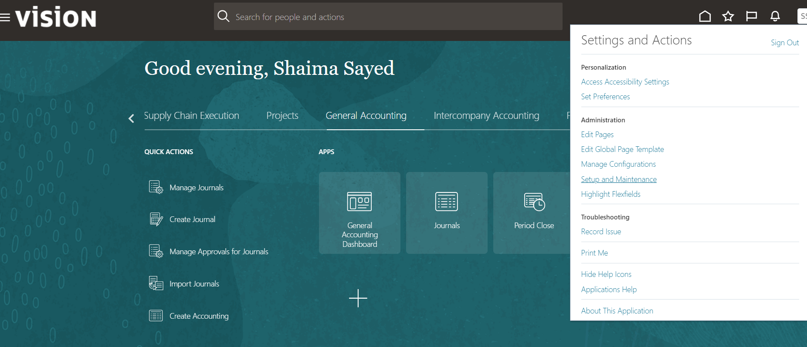

Slide 101
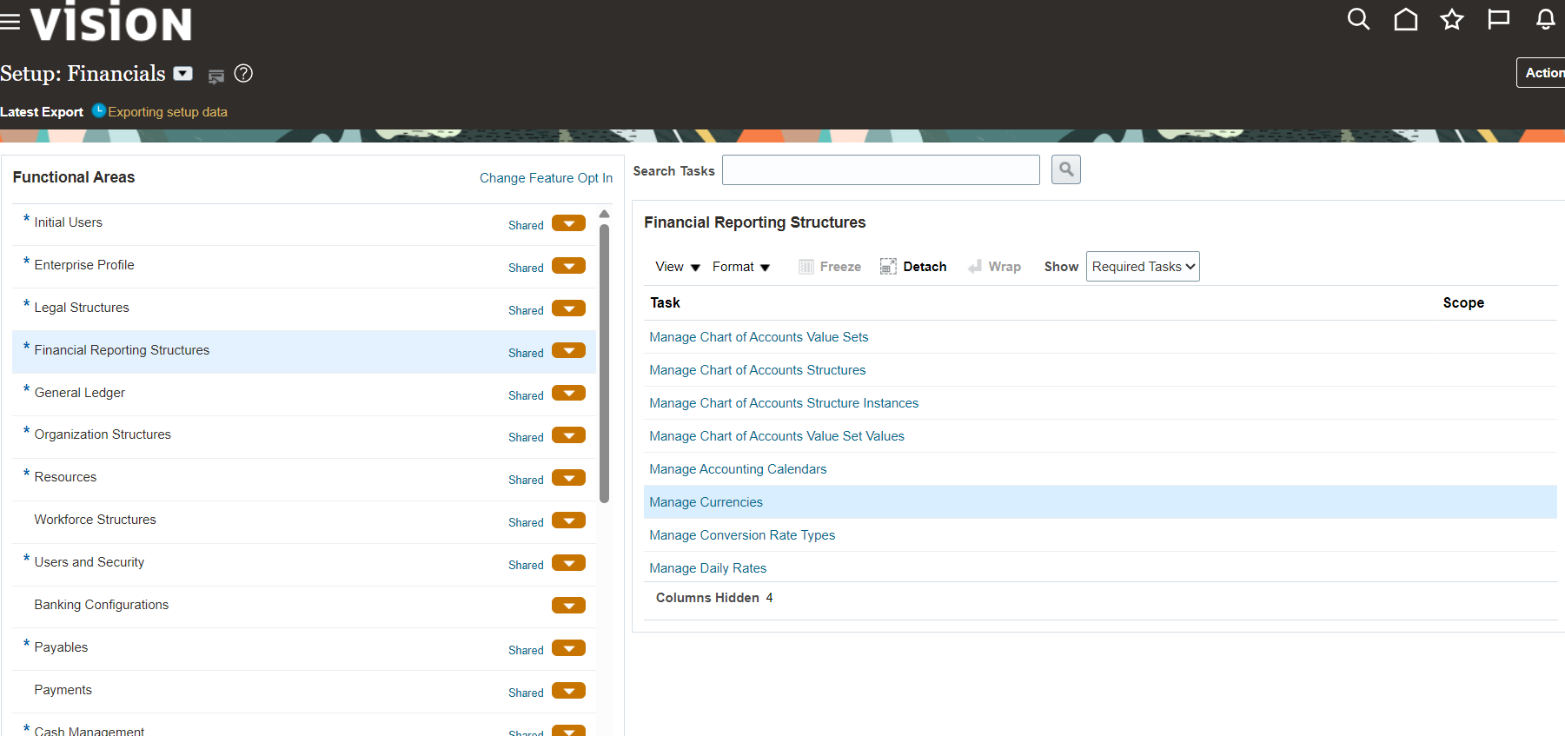
Within the functional area, select Financial Reporting Structure Subsequently, navigate to the Manage Currencies task

Slide 102
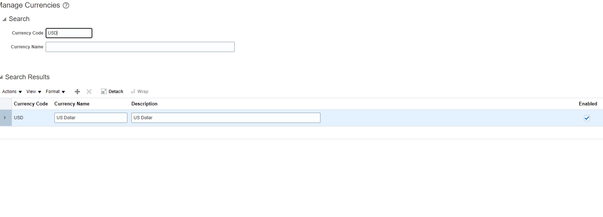
Through the search screen, search for the target foreign currency code to be used, such as USD, and verify that the currency is activated on the system by the presence of a ✔ mark in the Enabled field.

Slide 103
Activating the currency is an essential prerequisite prior to defining Daily Rates or entering Journals, as the system strictly prohibits accepting any financial transaction in an inactive currency.
It is also advisable to review the Start Date and End Date fields available on the same screen, to ensure the currency is valid for use within open accounting periods, thereby avoiding any future errors during period close.

Slide 104
Create Conversion Rate Type
Creating and classifying Conversion Rate Types and designating a Default type to organize multi-currency transactions, thereby facilitating and accelerating Journal entries through the automatic retrieval of this type.
Within the Financial Reporting Structures menu, select the Manage Conversion Rate Types task

Slide 105
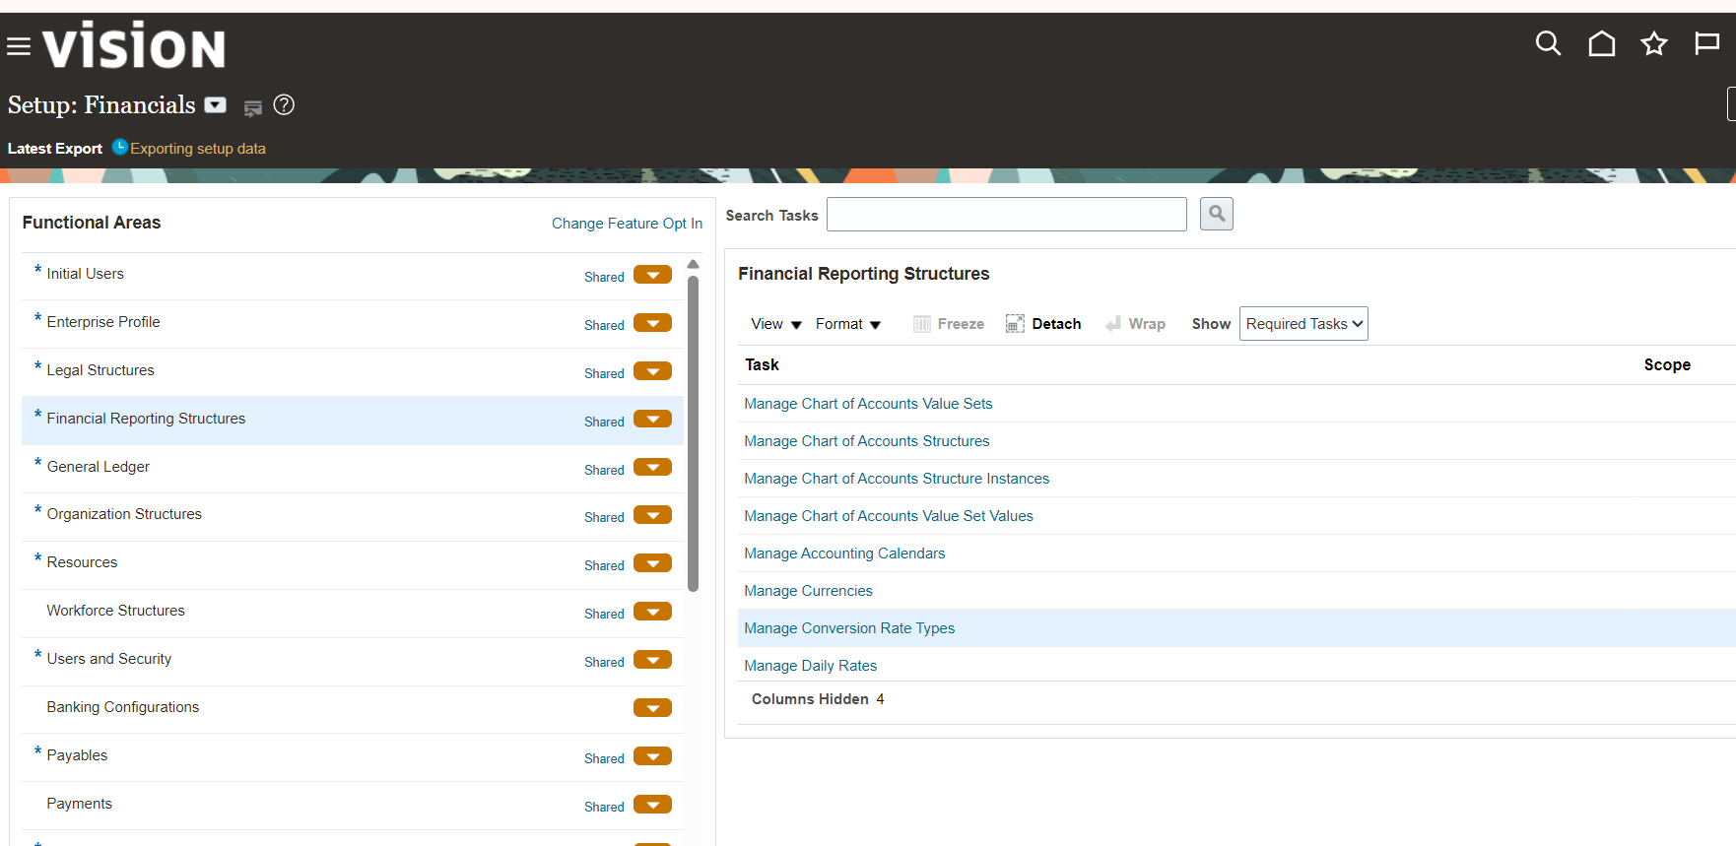
Create Conversion Rate Type

Slide 106
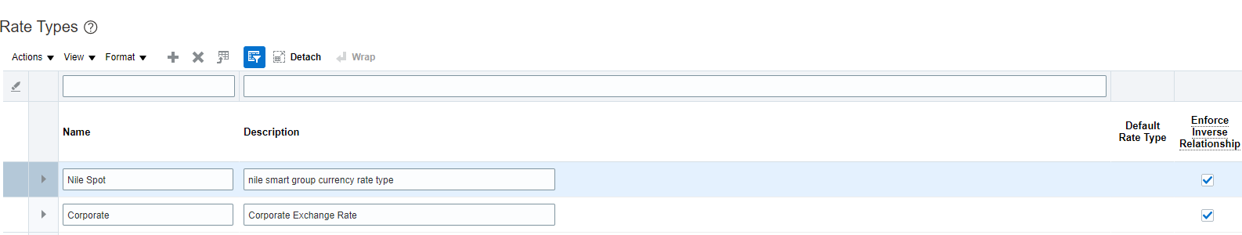
In the Currency Rates Manager screen, add a new Custom Rate Type, specifying its name and description as demonstrated by the creation of "Nile Spot".

Slide 107
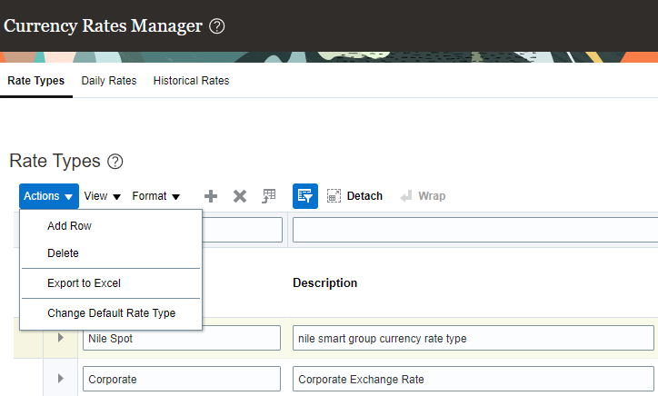
To designate this type as the system's default option, select its corresponding row, then open the Actions menu and select the Change Default Rate Type command

Slide 108
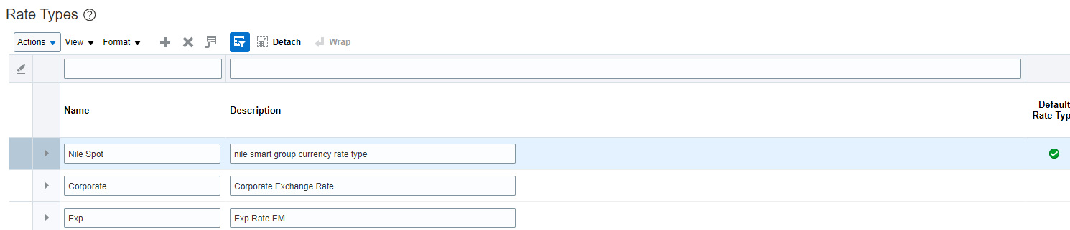
Upon saving, a green checkmark (✔) appears in the Default Rate Type column adjacent to the created rate, confirming its successful activation as the default option.

Slide 109
Designating the Default Rate Type is considered a best practice to mitigate human errors, as the system will automatically suggest this type to users when entering Journals or Payables and Receivables invoices.
Selecting the Enforce Inverse Relationship option ensures that the system calculates the inverse exchange rate automatically and with mathematical precision. For instance, if the USD to SAR conversion rate is entered, the system will automatically calculate and store the SAR to USD conversion rate.

Slide 110
Create Currency daily Rate
Verifying User Security & Roles to ensure the capability to download and utilize the ADF Desktop Integrator tool. This procedure is essential for enabling the automated mass upload of Daily Rates as an alternative to manual entry, thereby enhancing operational efficiency.

Slide 111
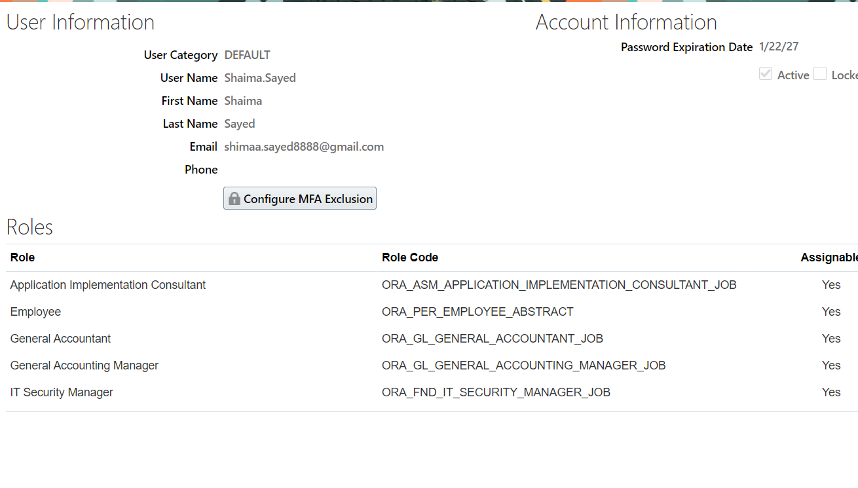
Prior to entering exchange rates, it is imperative to ensure that the user account possesses the Employee Role. This is verified through the user information screen, which displays the Assigned Roles, such as the Employee role, that grant access to system tools.

Slide 112

Secondly - Download ADF: Upon verifying the privileges, navigate to the Tools menu from the main menu, and select the Download ADF Desktop Integrator option. This tool establishes the communication bridge between Oracle and Microsoft Excel.

Slide 113

Thirdly - Create in Spreadsheet: Subsequently, navigate to the Currency Rates Manager screen, specifically to the Daily Rates tab. By clicking the Create in Spreadsheet button, the system will download a Smart Excel Template pre-configured to receive data.

Slide 114
Utilizing the ADF tool is the Standard Practice in Oracle Enterprise Implementations for uploading exchange rate data, particularly when the company deals with multiple currencies subject to daily fluctuations, as this approach optimizes time and prevents manual entry errors.
Automated mass entry and uploading of Daily Rates utilizing the ADF tool, and updating system tables with the conversion rates between foreign currencies and the Functional Currency for application to financial transactions.

Slide 115

Upon opening the downloaded Excel file, the system first requires Authentication by logging in with the Oracle Cloud user account to ensure secure data transmission

Slide 116

Entering Exchange Rate Data: The data is arranged within the table such that a distinct row is allocated for each currency pair. We specify the From Currency and the To Currency, and subsequently select the previously created Rate Type, such as "NileRate"

Slide 117
The From/To Conversion Date is entered, followed by the Conversion Rate. Given that the "Inverse Relationship" feature was previously enabled, the system will calculate the Inverse Rate automatically.
Upon completing the data entry, click the Submit option.

Slide 118

The Submission Options window will appear, where we must ensure the "Automatically submit daily rates import program" option is enabled, and subsequently click OK.

Slide 119

The system will process the data and display a Confirmation message indicating the number of successfully inserted records and the Process ID submitted to the Daily Rates Interface Table.

Slide 120
Ensuring the activation of the "Automatically submit daily rates import program" option is a critical step, as it guarantees the direct transfer of data from the Interface Tables to the system's Base Tables without the necessity of manually executing any supplementary programs from the user interface.
Observing the Record Status column within the Excel file, which transitions to "Inserted successfully" upon the successful completion of the process, provides the user with immediate confirmation regarding the integrity of the data entry.
Validating the preceding configurations by creating Journals in foreign currencies, ensuring the system automatically retrieves the exchange rates and accurately calculates the Functional Currency equivalent, in preparation for Revaluation processes.

Slide 121

By returning to the Currency Rates Manager screen and querying the imported currencies, such as SAR to EGP, it is clearly evident that the rates uploaded via ADF have been successfully recorded and their effective dates are active.

Slide 122

Create Journal With Functional & Foreign Currency
Navigate to the General Accounting application, then proceed to the Journals management screen to Create Journal.

Slide 123
Upon selecting a foreign currency such as USD and specifying the Accounting Date, the system immediately retrieves the default Rate Type: Nile Spot, along with the corresponding Conversion Rate for that day, automatically and without manual intervention..
Accounting Treatment (Entered vs. Accounted): Within the Journal Lines section, we observe the division of amounts into two primary components: o Entered USD: This represents the original transaction amount denominated in the foreign currency, signifying the actual transaction value. o Accounted EGP: This denotes the equivalent value in the Ledger's functional currency, which the system automatically calculates by multiplying the Entered Amount by the Conversion Rate (e.g., $10,000 × 48 = 480,000 EGP).

Slide 124

The segregation between the Entered and Accounted fields constitutes Oracle's fundamental mechanism to ensure that all transactions ultimately flow into the Trial Balance in a single currency (the Functional Currency), while preserving the original values for bank reconciliations and supplier/customer settlements.

Slide 125

Creating and Posting a diverse set of journal entries to establish sufficient balances for testing the subsequent Revaluation process.

Slide 126
Additionally, it is imperative to emphasize that the journal status must be Posted, as the Revaluation and Translation processes do not recognize Unposted journals.

Slide 127

Revaluation
Creating a Revaluation Template to calculate the variances resulting from exchange rate fluctuations on outstanding foreign currency balances at period-end, such as bank accounts, and automatically routing these variances to the Unrealized Gain/Loss accounts as a fundamental component of the Period-End Close procedures.

Slide 128

Through the Setup and Maintenance screen, navigate to the General Ledger functional area, and subsequently select the Manage Revaluations task.

Slide 129

On the Manage Revaluations screen, click the Add (+) icon to create a new Revaluation template

Slide 130

On the Edit Revaluation screen, enter the template's defining parameters, such as the Name "revaluation cash in bank", and specify the Chart of Accounts and the Revaluation Currency as USD

Slide 131
Link the template to the designated custom exchange rate type established for recording period-end rates (Conversion Rate Type: Nile Rate).
Clearly specify the reconciliation accounts within the Chart of Accounts to which the system will route the journal entries, specifically defining the Unrealized Gain Account and Unrealized Loss Account fields.
Within the Revaluation Accounts section, Filter Conditions are added to precisely designate the targeted accounts. In this instance, supplier, bank, and customer accounts were selected for balance revaluation.
The application of Account Filters ensures compliance with International Financial Reporting Standards (IFRS), as period-end revaluation must be strictly confined to Monetary Items, such as bank accounts, accounts receivable, and accounts payable. The template must not be applied to revenues, expenses, or fixed assets.
Automation & Fast Close: Enabling the "Post automatically" option is a pivotal step in accelerating the monthly close cycle. Upon completion of the revaluation process, the system instantaneously generates and posts the journal entry directly to the General Ledger without necessitating further manual intervention.
Revaluation Execution: The actual execution of the revaluation process calculates exchange rate variances for bank balances based on the configured template, automatically generating the corresponding Revaluation Journal within the General Ledger.

Slide 132

Returning to the Manage Revaluations screen, select the established "revaluation cash in bank" template, and subsequently click the Generate button.

Slide 133

The Basic Options window for process execution will appear, where we specify the process parameters, such as the Data Access Set and the Ledger, to ensure the journals are accurately routed to the correct ledger.
Specify the Accounting Period as Oct-26. Crucially, input the Accounting Date and the Rate Date; these are designated here as October 15, 2026, to align with the previously uploaded conversion rate

Slide 134

Upon clicking Submit, the system generates a Confirmation message providing the Process ID.
To monitor the execution status, navigate to the Scheduled Processes screen and query using the Process ID to verify that the Revalue Balances program has completed successfully with a Status of "Succeeded".

Slide 135

Reviewing and analyzing the accounting journal generated by the Revaluation process (Revaluation Journal), and verifying the accurate accounting routing for currency variances (Unrealized Exchange Gains/Losses) and their direct impact on the financial statements..
Navigating to the Manage Journals screen and querying for posted journals clearly reveals the automatically generated journal, designated with the Source and Category: Revaluation

Slide 136

Upon accessing the Journal Lines, we observe that the system utilized the updated Conversion Rate to calculate the variances.

Slide 137

Observe that the Entered USD field reflects a value of 0.00 for both lines. This occurs because the Revaluation process does not alter the actual USD bank balance; rather, it exclusively adjusts the equivalent Accounted EGP value within the ledger to align with the current market exchange rate.

Slide 138
Translation
Configuring the system to translate General Ledger Balances from the functional currency (EGP) to another reporting currency (USD) for the purpose of financial statement Consolidation or fulfilling parent company reporting requirements, while automatically routing translation variances to a designated adjustment account.
First - Prerequisites: Prior to initiating the translation process, we accessed the Specify Ledger Options screen to verify the configuration of the Cumulative Translation Adjustment (CTA) Account, and to assign the default exchange rate types (Default Period End/Average Rate Type).

Slide 139


Slide 140

- Creating the Reporting Currency: From the General Accounting setup menu, navigate to the Manage Reporting Currencies task.

Slide 141

On the review screen for the ShaimaaProGL EG Ledger, click the Add (+) icon to create a new translation setup.

Slide 142
On the Create Reporting Currency screen, we configured the following pivotal settings: o Currency Conversion Level: 'Balance' was selected, indicating that the system will exclusively translate the final balances at month-end, rather than individual journal entries. o Currency: Designated the US Dollar (USD) as the target reporting currency. o Translation Options: Utilized the "Nile Rate 2" for both the Period Average Rate and the Period End Rate. o Accounting Translation Rules: Specified the Period-To-Date (PTD) rule for translating revenues and expenses, and the Year-To-Date (YTD) rule for translating equity

Slide 143


Slide 144
The actual execution of the Translate Balances program to convert ledger values into the target reporting currency, followed by an analytical Balance Inquiry to verify the accuracy of the translated balances and ensure the ability to trace the Audit Trail down to the detailed journal entry level.

Slide 145

From the Period Close dashboard, navigate to the tasks list and select to run the Translate Balances program

Slide 146

On the Basic Options screen, specify the execution parameters such as the Ledger, the Target Currency: USD, the Accounting Period, and the Balancing Segment: 10, then click Submit.

Slide 147

The system generates a Process ID to confirm the initiation of the process.

Slide 148

Inquiry & Reconciliation: To verify the results, return to the Period Close screen and select the Inquire on Detail Balances task.

Slide 149
On the search screen, to specifically focus on foreign currency accounts, designate the Currency Type as "Entered" and select "USD" as the currency.
The search results provide a comprehensive dual-balance presentation: one line details the balance in the foreign currency (USD), while another line displays its local currency equivalent (EGP), covering the opening balance, period activity, and ending balance.

Slide 150


Slide 151

For deeper analysis, clicking directly on any of the displayed balances navigates to the Journal Lines detail screen. This view displays every individual journal entry that contributed to the formation of this balance, clearly illustrating both the Entered and Accounted values for each transaction.

Slide 152
By clicking on any balance, users can drill down into the detailed journals and underlying transactions. This drill-down capability empowers Financial Managers and Auditors to navigate seamlessly from the translated Summary Balance down to the Source Transaction with a single click, ensuring the highest levels of transparency and compliance.
Utilizing the "Currency Type: Entered" filter displays the transactions executed in both the foreign and local currencies simultaneously. This visibility significantly streamlines the process for accountants to accurately reconcile foreign Bank Statements.

Slide 153
Budget

Slide 154
Introduction to Budget in Oracle Fusion
A Budget in Oracle Fusion General Ledger (GL) is a financial plan that estimates a company's expected income and expenses over a specific period, usually a fiscal year.
It helps organizations plan how their financial resources will be allocated across different accounts and departments, monitor spending, and compare planned amounts with actual financial results.

Slide 155
For example, a company may allocate EGP 120,000 annually for salaries, EGP 24,000 for rent, and EGP 18,000 for electricity. These amounts represent the planned budget, while actual expenses reflect what the company really spends.
In Oracle Fusion, the budget can be entered for specific account combinations and accounting periods, such as January through December 2026. This allows the company to track its financial performance and identify differences between budgeted and actual amounts.

Slide 156
The main objectives of budgeting are to:
Plan and allocate financial resources.
Control and monitor expenses.
Compare budgeted amounts with actual results.
Support financial analysis and decision-making.
Help ensure spending stays within approved limits when Budgetary Control is configured.
In summary: Budgeting in Oracle Fusion helps an organization plan its finances, monitor performance, and make informed financial decisions throughout the fiscal year.

Slide 157

Step 1 is adding the role

Slide 158

After signing in click on the navigator

Slide 159

From the navigator click and tools to drop the list and choose security console
Click on users and search for the user and click edit to add the role, search on budget manager and click add role membership and make sure this will be enabled

Slide 160

Step 2 Creating person
Click on the icon that has your name and click setup and maintenance

Slide 161

From the top of the screen choose from the offering financials and choose from the dropdown menu users and security and click on manager users

Slide 162

Click on (+) and a screen will be displayed to put the first and last name, email and hiring date.

Slide 163

In the employment information we need to choose the prompt type, and connect the legal entity and business unit will the person use.
Click save and close then done.

Slide 164

Step 3 add manager
From setup and maintenance choose Organization structure then choose manager Business unit.

Slide 165

Search for the business unit and choose it

Slide 166

Put the manager that you created and click save and close.

Slide 167

Creating budget has 4 steps
Enable budgetary control and encumbrance account
From budgetary control and encumbrance account click manage control

Slide 168

Search for your ledger and choose it, a screen will be displayed make sure that you enabled budgetary control and Encumbrance accounting, and add the encumbrance accounting we added 10-100-24990-10-1000 as encumbrance accounting for our company.

Slide 169
On the chart of account, we added company department, account, product, and project
Click save then save and close.

Slide 170

2-Make a calendar for budget
Click on manager control budget then + create

Slide 171

Make sure your putting name, connecting budget calendar with the ledger, choose the periods (start and end), the source type, currency, the budget manager and the source budget name.

Slide 172

Click action and make it in use then Click save and close ( waring message will be displayed click yes)

Slide 173

Step 3 Manage Control Budget Data Access for Users:
From setup and maintenance click from the offering on the budgetary control and encumbrance account then Manage Control Budget Data Access for Users
Click create and add the user’s name, role and connect it with the business unit
Click save and close.

Slide 174

4- Open periods
We have 2 options to reach budgetary control from the navigate or the home page

Slide 175

From the task list choose budget period status

Slide 176

Make sure you’re opening all the periods you will use.
Click save and close

Slide 177

From the task list choose Enable budget on spread sheet and put the budget usage and control budget
Make sure you’re choosing new budget or replacement then click on create spread sheet

Slide 178

After downloading the excel sheet sign in and put the account the details on the budget from Jan till Dec.

Slide 179

Click on submit and from schedule process on the navigator check if it’s running successfully.

Slide 180

Transfer and increase
To transfer Click on review budgetary control balance

Slide 181

Search for the budget name that you create, put the company account project and everything and the balances will be displayed

Slide 182

NSS wanted to transfer EGP 500 from Insurance to Advertising to cover additional marketing expenses for January 2026. This transfer reallocates the existing budget without increasing the total budget.

Slide 183

Click on the account and select transfer from and then select on the other account and select transfer

Slide 184

to Put the amounts and then put the Justifications then click submit

Slide 185

A request will be running and will reflect on the balances.

Slide 186

or you can increase account’s budget through editing the amounts from task list – ener budget in spreadsheet (but this time you will choose budget entry classification as a revision)

Slide 187


Slide 188

NSS created a Budget Revision for Account 52152, increasing the budget by 500 EGP per month from January through December 2026. ✅

Slide 189


Slide 190

Check Funds and Reserve Funds
Business Scenario
The organization wants to reserve EGP 10,000 for future office supply purchases and ensure that sufficient budget is available.

Slide 191

Step 1: Create Journal
Navigate to:
General Accounting → Journals → Create Journal
Enter:
Journal Batch: ENC_2026
Description: Reserve Budget for Future Purchase
Journal: ENC_JRN_001
Ledger: NSS Primary Ledger EG
Accounting Date: 30-Jun-2026

Slide 192

Step 2: Enter Journal Lines
Line 1
Account: 52152
Debit: 10,000
Credit: 0
Description: Office Supplies Commitment
Line 2
Account: 53110
Debit: 0
Credit: 10,000
Description: Encumbrance Reserve

Slide 193

Step 3: Save Journal
Click Save.
Step 4: Check Funds
From Journal Actions select:
Check Funds
Result
✅ Funds Status = Passed
✅ Sufficient budget is available.
✅ Budget validation completed successfully.

Slide 194
Step 5: Reserve Funds
From Journal Actions select:
Reserve Funds
Result
✅ Funds Reserved Successfully
✅ EGP 10,000 reserved against the control budget.
✅ Available budget reduced by EGP 10,000.

Slide 195
Step 6: Post Journal
Click Post.
Result
✅ Journal posted successfully.
✅ Budget commitment recorded

Slide 196


Slide 197


